Slide 1
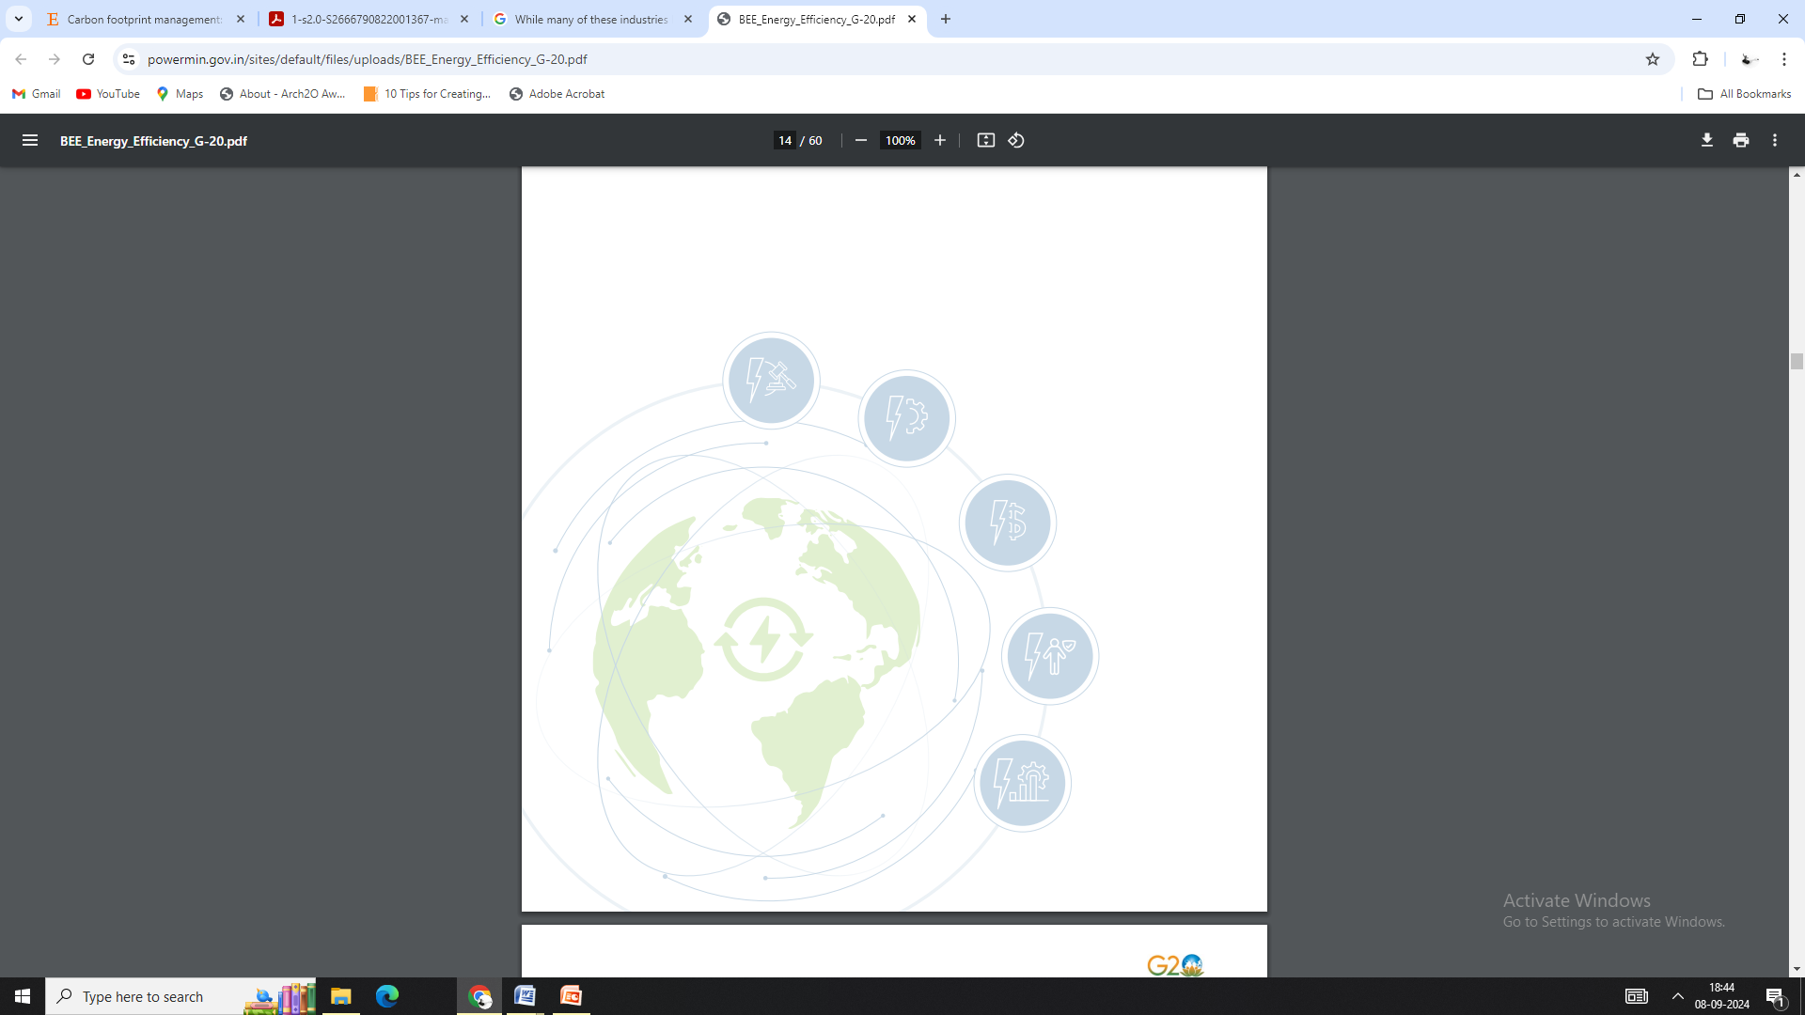
THESIS TOPIC:
“CARBON FOOTPRINT & PLANNING : Low-Carbon Water Utility & Municipal Waste Management plan for JNAC, Jamshedpur .”
THESIS GUIDES:
Dr. TIWARI PAVAN KUMAR
Ar. RITU AGRAWAL
SEMESTER – IV
MASTER OF URBAN PLANNING
SUB: AR 751- THESIS
DEPT. OF ARCHITECTURE & PLANNING
BIT MESRA,RANCHI
PRESENTED BY:

Slide 2
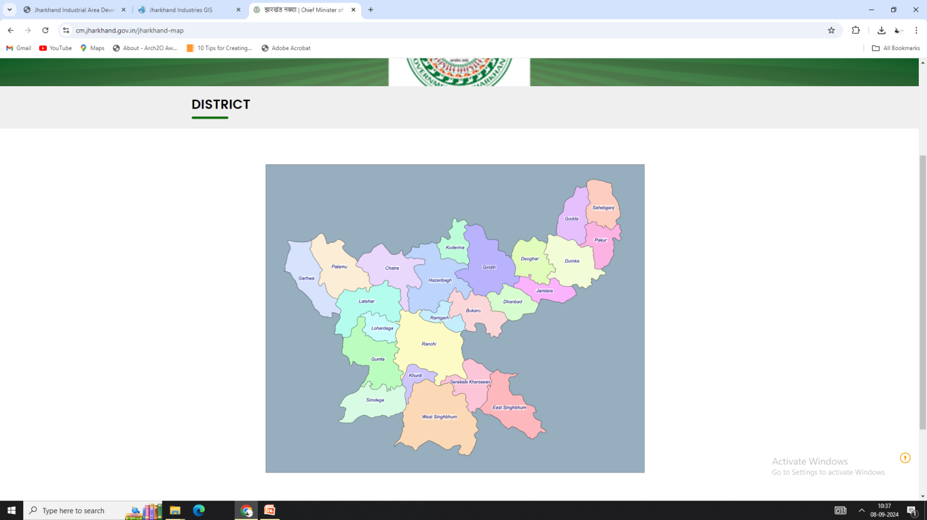
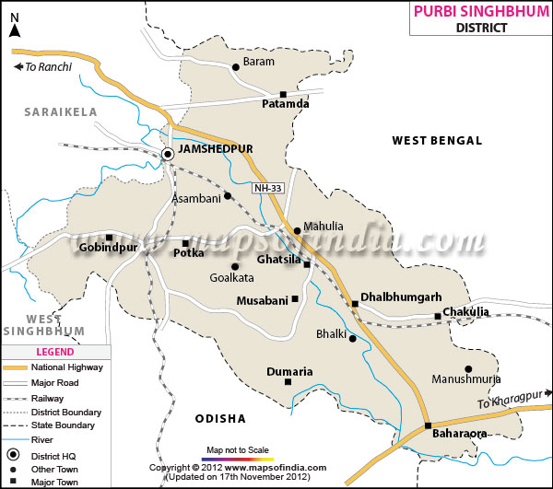
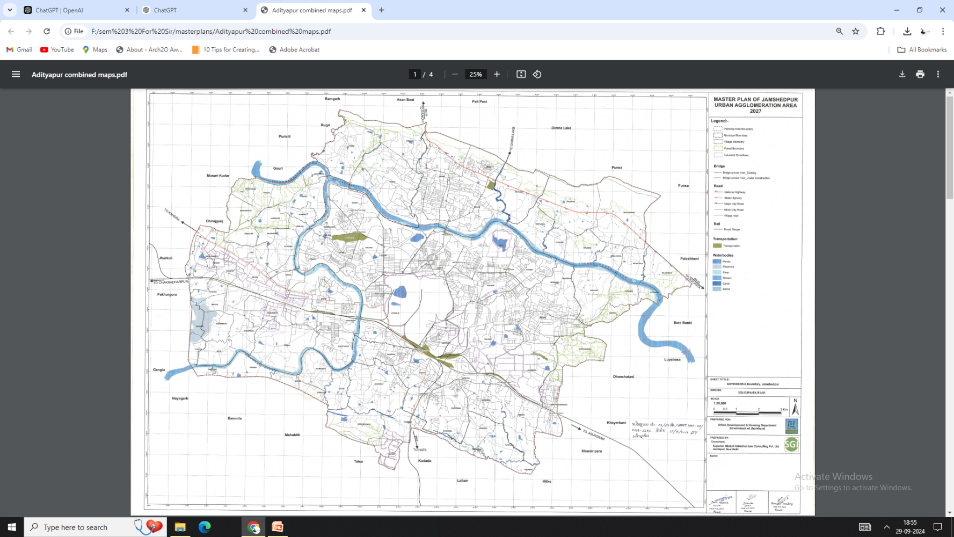
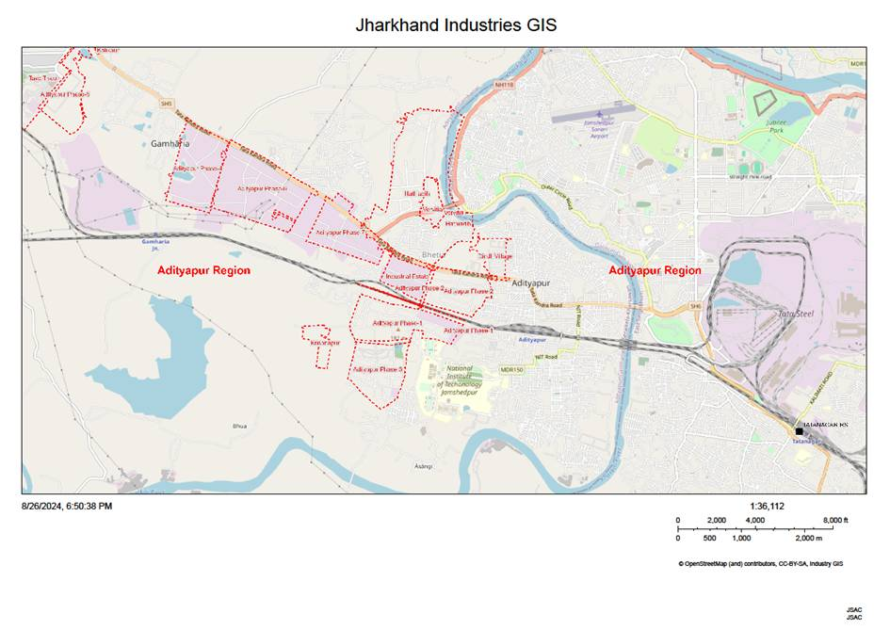
03a.
PROFILE OF THE STUDY AREA
Study Area Profile: Jamshedpur Notified Area Committee (JNAC)
Location and Geographic Overview:
City: Jamshedpur
State: Jharkhand, India
Coordinates: Approx. 22.8046° N, 86.2029° E
Area Covered: JNAC manages an area of about 64 sq. km within Jamshedpur, the largest city in Jharkhand.
Boundaries:
North: River Subarnarekha
South: River Kharkai and Tata Steel Plant
West: Adityapur Industrial Area
East: Suburban areas of Jamshedpur and river belts.
Administrative Jurisdiction:
Governance Type: Municipal Administrative Body (Urban Local Body)
Parent Body: Department of Urban Development, Housing, and Planning, Government of Jharkhand
Administrative Divisions: Divided into 56 wards, each governed by elected ward councillors.
Population (2021 Census): Approx. 700,000 under JNAC jurisdiction.
Density: 10,937 people per square km (approx.)
Demographics and Socioeconomic Characteristics:
Literacy Rate: Over 85%, higher than the national average.
Primary Languages: Hindi, Bengali, English, and regional dialects.
Primary Occupation Sectors:
Industrial Workforce: Jamshedpur is an industrial hub, with a significant population working in sectors such as steel, automobile manufacturing, and allied industries.
Services Sector: IT services, healthcare, and education also contribute significantly to the local economy.
Small-scale Enterprises: Handicrafts, retail, and small-scale industries contribute to the urban economic ecosystem.
(Source: https://udhd.gov.in/map-of-Jharkhand/)
(Source: https://Jharkhand.nic.in/map-of-district/)
Fig02: Jharkhand Map
Fig03: East Singhbhum District
(Source: JNAC,UDHD-Jharkhand)
Fig04: Jamshedpur Urban Area(JUA)
(Source: JSAC)
DISSERTATION & PLANNING SEMINAR
AR751:THESIS/DISSERTATION
TOPIC: Low-Carbon Water Utility & Municipal Waste Management plan for JNAC, Jamshedpur
RAM KUMAR , MUP/10002/23
SEM-IV , MUP 2023-25
02

Slide 3
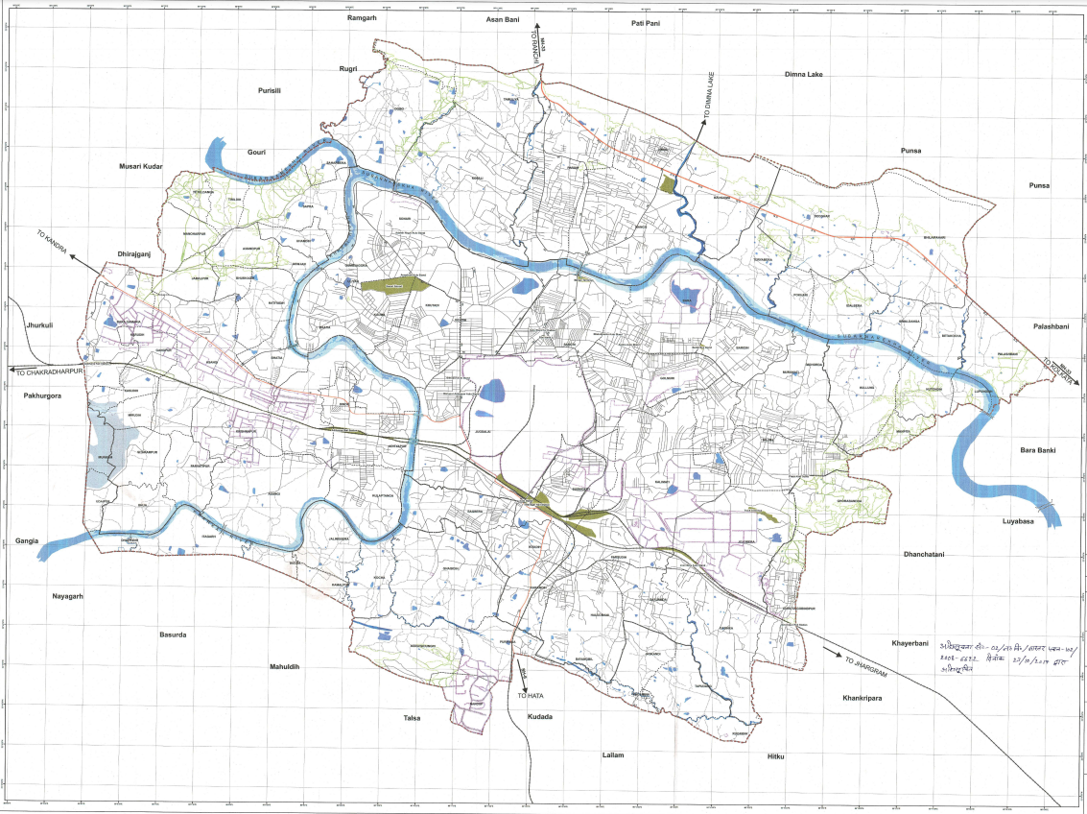
03b.
PROFILE OF THE STUDY AREA
Infrastructure and Urban Facilities:
Water Supply and Sanitation:
JNAC is responsible for water distribution, sanitation, and waste management across its jurisdiction.
Water Sources: Primarily sourced from the rivers Subarnarekha and Kharkai.
Current Challenges: Issues with water distribution, outdated sewerage infrastructure, and intermittent water shortages, particularly in the dry seasons.
Waste Management:
A critical aspect of JNAC’s work involves the management of solid and liquid waste, including municipal waste collection, treatment, and disposal.
Waste-to-Energy Initiatives: The area has potential for adopting low-carbon waste management strategies, including biogas generation and composting projects.
Sewerage System:
While parts of Jamshedpur have modernized sewerage systems, many areas under JNAC lack robust sewage treatment facilities.
Efforts are ongoing to modernize the system and manage wastewater in line with environmental standards.
Climate and Environmental Conditions:
Climate: Jamshedpur experiences a tropical climate, characterized by hot summers, monsoon rains, and mild winters.
Rainfall: Receives an average of 1200-1400 mm of annual rainfall, mostly during the monsoon season (June to September).
Environmental Concerns:
Rising air pollution due to industrial activity and traffic congestion.
High carbon emissions from industries and automobiles.
Threats to river ecosystems due to untreated industrial and municipal effluents
Fig05: Jamshedpur Urban Area(JUA)
(Source: JSAC)
JNAC’s urban area, situated within a major industrial city, makes it a crucial zone for applying frameworks like Low-Carbon Water Utility Management and Carbon Footprint Management, aligning with India’s Nationally Determined Contributions (NDCs) towards 2030 climate goals
(Source: JNAC,UDHD-Jharkhand)
DISSERTATION & PLANNING SEMINAR
AR751:THESIS/DISSERTATION
TOPIC: Low-Carbon Water Utility & Municipal Waste Management plan for JNAC, Jamshedpur
RAM KUMAR , MUP/10002/23
SEM-IV , MUP 2023-25
03

Slide 4
04.
AIM & OBJECTIVES
AIM:
To formulate Low-Carbon Water Utility & Municipal Waste Management plan for JNAC, Jamshedpur aligned with India’s Nationally Determined Contributions (NDCs) 2030.
OBJECTIVES:
01.
To identify parameters of carbon footprint assessment and study carbon footprint assessment methods applicable for JNAC(water utility & Municipal waste) .
02.
To assess the current carbon footprint of the JNAC and identify major carbon footprint contributing process & practices(water utility & Municipal waste).
03.
To identify the gap between the current emissions scenario with desired outcomes as per India’s NDC 2030 targets and propose Science Based Targets(SBT).
04.
To develop & propose a comprehensive CMP(Carbon management plan) with an evaluation/monitoring framework for JNAC (water utility & Municipal waste management).
DISSERTATION & PLANNING SEMINAR
AR751:THESIS/DISSERTATION
TOPIC: Low-Carbon Water Utility & Municipal Waste Management plan for JNAC, Jamshedpur
RAM KUMAR , MUP/10002/23
SEM-IV , MUP 2023-25
05

Slide 5
05.
SCOPE & LIMITATIONS
SCOPE:
01.
The dissertation intends to study water utility & Municipal waste within the JNAC focusing on processes and practices that contribute to carbon emissions.
The study will specifically assess the current emissions scenario in JNAC(water utility & MSW ) while projecting forward to align with the 2030 targets set under India's NDCs.(excludes BMW & industrial wastes)
02.
03.
The proposed carbon management framework will include specific emission reduction strategies and recommendations relevant to the JNAC context and aligned with India’s NDC 2030.
LIMITATION:
01.
Limitations include availability of data for up-to-date data on energy consumption, emissions, water utility and Municipal waste.
02.
Also, proposed carbon management framework for JNAC(water utility & Municipal waste) may need adaptation for applicability in areas of similar characteristics.
DISSERTATION & PLANNING SEMINAR
AR751:THESIS/DISSERTATION
TOPIC: Low-Carbon Water Utility & Municipal Waste Management plan for JNAC, Jamshedpur
RAM KUMAR , MUP/10002/23
SEM-IV , MUP 2023-25
06

Slide 6
06.
FINAL METHODOLOGY
01
02
03
FORMULATION
OF
AIM & OBJECTIVES
BACKGROUND STUDY
TOPIC FORMULATION
LITERATURE STUDY
04
GLOBAL PERSPECTIVE
NATIONAL PERSPECTIVE
IPCC REPORTS
POLICY PAPERS
JOURNALS
LITERATURE REVIEWS
THEORIES & CONCEPTS
IPCC AR6,GHG Protocol,ISO,LCA
RESEARCH JOURNALS
CASE STUDIES
MITIGATION STRATEGIES
IDENTIFICATION OF METHOD & PARAMETERS
OBJ-01
CRITERIA/METHODS FOR DATA COLLECTION
TOOLS FOR CFA & DATA ANALYSIS
ISO compliant HLCA
(ISO:14040,ISO:14044)
05a
05
SCOPE & LIMITATIONS
STUDY AREA
08a
OBJ-02
BASELINE CARBON FOOTPRINT ASSESSMENT LCA USING OpenLCA/Simapro
06
DECISION FOR BASELINE EMISSION STUDY(LCA}
08b
OBJ-02
SCENARIO ANALYSIS
USING OpenLCA/Simapro
GOAL & SCOPE DEFINITION
08
DATA ANALYSIS
(USING OpenLCA/Simapro software and Ecoinvent Database)
07
DATA COLLECTION
(JUSCO,JNAC)
FUNCTIONAL UNIT DEFINITION
08c
SYSTEM BOUNDARY SETTING
OBJ-03
GAP IDENTIFICATION
(CURRENT SCENARIO & NDC’s)
REFERENCE FLOW DEFINITION
09
SENSITIVITY ANALYSIS
(Montecarlo Simulation using OpenLCA/Simapro)
08d
OBJ-03
SBT BASED TARGET SETTING
(SHORT TERM & LONG TERM TARGET)
11a
CMP FRAMEWORK
(Carbon Management Plan)
OBJ-04
10
KEY FINDINGS & INTERPRETATION
(ISO:14040,ISO:14044,AR-06)
12
11
OUTCOME
FINAL PROPOSAL
11b
ACTION PLAN
(with evaluation & monitoring )
OBJ-04
Fig06: Brief Methodology
(Source: Author)
DISSERTATION & PLANNING SEMINAR
AR751:THESIS/DISSERTATION
TOPIC: Low-Carbon Water Utility & Municipal Waste Management plan for JNAC, Jamshedpur
RAM KUMAR , MUP/10002/23
SEM-IV , MUP 2023-25
06

Slide 7
WORKFLOW FOR STUDY:BASELINE CARBON FOOTPRINT ASSESSMENT
TOOLS & TECHNIQUES TO BE ADOPTED STAGEWISE
WORKFLOW | PROCESS | TOOLS & TECHNIQUES | WATER CYCLE (INCLUDING WASTEWATER) | MUNICIPAL SOLID WASTE (MSW)
Goal & Scope Definition | Define system boundaries | ISO 14040/14044:2019, O-LCA (Organizational LCA), Hybrid LCA | System boundary includes potable water supply, wastewater treatment, stormwater management | MSW system boundaries include waste generation, collection, transport, treatment, disposal
Emission Categories | Identify Scope 1, 2, 3 emissions | IPCC AR6 2022 Guidelines, GHG Protocol, ISO 14064-1:2018 | Scope 1: direct emissions from wastewater treatment; Scope 2: energy use for water facilities; Scope 3: indirect emissions (supply chain) | Scope 1: direct emissions from landfills and incineration; Scope 2: energy for waste facilities; Scope 3: upstream/downstream activities
Functional Unit | Select functional unit for study | ISO 14040:2019 | Functional unit can be volume of water treated or supplied, cubic meters, or population served | Functional unit: tons of waste treated, population served, or area managed
Data Collection | Identify primary/secondary data sources | IPCC AR6 emission factors, ecoinvent (Hybrid LCA databases) | Water consumption data, wastewater treatment processes, energy use for water facilities | Waste generation data, treatment options (landfill, recycling, composting), energy use in collection, transport
GHG Inventory | Inventory of GHGs emitted by processes & sources | IPCC AR6 2022, GHG Protocol, Hybrid LCA tools (OpenLCA, SimaPro) | Methane (CH₄) and nitrous oxide (N₂O) from wastewater treatment, CO₂ from energy use | Methane (CH₄) from landfills, CO₂ from incineration, transportation emissions
Emission Factors | Apply relevant emission factors | IPCC AR6 2022, ISO 14064-1:2018, ecoinvent Hybrid LCA databases | IPCC AR6 wastewater emission factors, energy factors for water utilities | IPCC AR6 waste emission factors, energy for waste facilities, transport emission factors
Impact Assessment | Assess environmental impacts of emissions | ReCiPe 2016, S-LCA software (Social Hotspots Database), OpenLCA, SimaPro | Environmental impacts of water extraction, energy use, chemical use in treatment | Environmental impacts of waste treatment, landfill leachate, recycling efficiency, waste diversion
Uncertainty Analysis | Perform sensitivity/uncertainty analysis | SimaPro Monte Carlo simulation | Uncertainty in water use data, treatment technologies, future water demand | Uncertainty in waste generation rates, collection efficiencies, future waste projections
Normalization & Weighting | Normalize and weight environmental impacts | ReCiPe 2016, CML 2001, TRACI, Social LCA databases | Normalize based on water usage per capita or unit of service | Normalize per unit of waste treated or diverted from landfill
Reporting & Documentation | Prepare carbon footprint report | GHG Protocol for Cities (GPC), ISO 14064-1:2018, O-LCA framework | Reporting based on energy use for water/wastewater treatment, emissions, and water reuse rates | Reporting on emissions from waste treatment, recycling efficiency, landfill gas capture, and energy recovery
Verification & Validation | Validate carbon footprint and social impacts | ISO 14064-3:2019, PAS 2050 | Validation of emissions from water supply and treatment facilities, energy audits | Validation of waste data, landfill gas recovery, energy use, third-party audits
Reduction Strategy | Develop GHG and social impact reduction strategies | IPCC AR6 2022, Marginal Abatement Cost Curve (MACC), Hybrid LCA | Water-saving measures, energy-efficient wastewater treatment, water reuse and recycling programs | Waste reduction strategies (recycling, composting), methane capture from landfills, energy recovery from waste
(Source: ISO 14040, ISO:14044,IPCC 2022 AR6 Guidelines)
DISSERTATION & PLANNING SEMINAR
AR751:THESIS/DISSERTATION
TOPIC: Low-Carbon Water Utility & Municipal Waste Management plan for JNAC, Jamshedpur
RAM KUMAR , MUP/10002/23
SEM-IV , MUP 2023-25
07

Slide 8
PARAMETERS FOR CARBON BASELINE FOOTPRINT ASSESSMENT
WATER CYCLE
MUNICIPAL SOLID WASTE
PARAMETER CATEGORY | PARAMETER | DESCRIPTION | UNIT
Water Abstraction | Water source availability | Availability of water in surface or groundwater sources. | m³/day
 | Abstraction rate | Rate of water withdrawn from natural sources. | m³/day
 | Seasonal variation in source flow | Changes in water availability across seasons. | % change
 | Pumping energy consumption | Energy required for pumping water from the source. | kWh/m³
 | Source water quality | Quality indicators of source water (e.g., turbidity, pH, contaminants). | ppm
Water Treatment | Treatment efficiency | Efficiency of processes like filtration, disinfection, and sedimentation. | %
 | Chemical usage in treatment | Amount of chemicals (e.g., chlorine, alum) used in treatment. | mg/L or kg/day
 | Treatment plant capacity | Maximum water treatment capacity of the plant. | m³/day
 | Sludge generation | Amount of sludge produced per unit of water treated. | kg/m³
 | Energy consumption in treatment | Energy used for treatment processes per unit of water treated. | kWh/m³
Water Supply | Distribution network efficiency | Efficiency of the water supply distribution system (leakage rates). | %
 | Leakage rate | Water lost due to leaks in the supply network. | %
 | Pressure in supply network | Pressure maintained in distribution pipes. | psi
 | Customer metering coverage | Proportion of customers with water meters. | %
 | Energy consumption for distribution | Energy needed for distributing water through the network. | kWh/m³
Wastewater Collection | Collection efficiency | Efficiency of wastewater collection from households and businesses. | %
 | Infiltration and inflow rates | Rate of groundwater or stormwater entering the sewage system. | m³/day or %
 | Sewer network capacity | Maximum capacity of the sewage collection system. | m³/day
 | Pumping energy for wastewater collection | Energy consumed in pumping wastewater through collection network. | kWh/m³
 | Frequency of blockages or overflows | Frequency of system blockages or overflows in collection network. | Events/month
Wastewater Treatment | Treatment efficiency (BOD/COD removal) | Efficiency in removing contaminants like BOD/COD. | %
 | Chemical usage for treatment | Amount of chemicals used in wastewater treatment (e.g., coagulants, disinfectants). | mg/L or kg/day
 | Sludge production | Amount of sludge generated per unit of wastewater treated. | kg/m³
 | Energy consumption in treatment | Energy used for wastewater treatment processes per unit of wastewater treated. | kWh/m³
 | Treated effluent quality | Quality indicators of treated effluent (e.g., BOD, nitrogen, phosphorus levels). | mg/L
Environmental Impact | GHG emissions from water treatment | Emissions from treatment plants per unit of water treated. | tons CO₂e/m³
 | GHG emissions from wastewater treatment | Emissions from wastewater treatment processes per unit of wastewater treated. | tons CO₂e/m³
 | Effluent discharge compliance | Compliance rate with regulatory standards for effluent discharge. | %
 | Sludge disposal method | Method used for disposing of sludge (landfill, composting, etc.). | Qualitative
Economic | Cost of water treatment | Operating cost per unit of water treated. | Rs/m³
 | Cost of wastewater treatment | Operating cost per unit of wastewater treated. | Rs/m³
 | Revenue from treated water supply | Income generated from water supplied to consumers. | Rs/m³
 | Revenue from sludge byproducts | Income from byproducts (e.g., biogas, compost) from sludge treatment. | Rs/kg or Rs/m³
 | Infrastructure maintenance cost | Annual maintenance cost for the entire water and wastewater infrastructure. | Rs/year
Policy & Regulatory | Water quality standards | Standards for water quality that need to be met. | mg/L
 | Effluent discharge standards | Regulatory standards for treated effluent quality. | mg/L
 | Pricing policies | Policies determining water and wastewater treatment pricing. | Rs/m³
 | Carbon pricing | Applicable carbon tax for emissions from treatment processes. | Rs/ton CO₂
PARAMETER CATEGORY | PARAMETER | DESCRIPTION | UNIT
Waste Generation & Composition | Per capita waste generation rate | Waste generated per person per day. | kg/person/day
 | Waste composition proportions | Percentage of waste types (e.g., organics, plastics, metals). | %
 | Seasonal variation | Changes in waste generated across seasons or holidays. | % change
Collection & Transportation | Collection efficiency | Efficiency of waste collection from households and businesses. | %
 | Vehicle fuel efficiency | Fuel consumption per distance or weight of transported waste. | liters/km or liters/ton-km
 | Distance to treatment/disposal sites | Average distance covered in waste transport. | km
 | Frequency of waste collection | Number of times waste is collected in a given period. | times/week
Treatment & Processing | Recycling rate | Percentage of recyclable waste that is actually recycled. | %
 | Composting efficiency | Efficiency of composting facilities in processing organic waste. | %
 | Energy recovery efficiency | Efficiency of waste-to-energy facilities. | %
 | Landfill diversion rate | Percentage of waste diverted away from landfill. | %
Environmental Impact | Greenhouse gas (GHG) emissions factors | Emissions from different waste processing and disposal activities. | tons CO₂e/ton waste
 | Leachate generation | Amount of leachate generated per unit of waste in landfills. | liters/ton waste
 | Emissions from incineration | Pollutants generated per unit of waste incinerated. | tons CO₂e/ton waste
 | Odor and air pollutants | Levels of odor-causing compounds and air pollutants from processing sites. | ppm or μg/m³
Economic | Cost of collection & transportation | Cost per ton or per distance for waste collection services. | Rs/ton or Rs/km
 | Operational costs of treatment facilities | Cost of operating recycling, composting, and energy recovery facilities per ton of waste. | Rs/ton
 | Landfill disposal costs | Cost of landfill disposal per ton of waste. | Rs/ton
 | Revenue from recyclables | Income generated from selling recyclable materials. | Rs/ton
 | Energy/resource recovery revenue | Revenue from energy recovery (e.g., electricity from waste-to-energy). | Rs/kWh or Rs/ton
Policy & Regulatory | Waste diversion targets | Targeted reduction in waste sent to landfills as per policy goals. | %
 | Carbon pricing | Applicable carbon tax or cost per ton of CO₂ emissions. | Rs/ton CO₂
 | Subsidies and incentives | Financial incentives for recycling, composting, and waste-to-energy. | Rs/ton or %
(Source: IPCC 2022:AR06, CH-5; Ecoinvent Database)
DISSERTATION & PLANNING SEMINAR
AR751:THESIS/DISSERTATION
TOPIC: Low-Carbon Water Utility & Municipal Waste Management plan for JNAC, Jamshedpur
RAM KUMAR , MUP/10002/23
SEM-IV , MUP 2023-25
08

Slide 9
GOAL & SCOPE DEFINITION:BASELINE CARBON FOOTPRINT ASSESSMENT
GOAL & SCOPE DEFINITION:
APPROACH: CRADLE TO GRAVE APPROACH
GOAL
TO EVALUATE THE CARBON FOOTPRINT (CF) of WATER CYCLE( WHICH INCLUDES STAGES OF WATER ABSTRACTION,WATER TREATMENT,WATER SUPPLY, WASTEWATER COLLECTION & WASTERWATER TREATMENT) AND MUNICIPAL SOLID WASTE (WHICH INCLUDES STAGES OF PRE-COLLECTION,TRANSPORTATION, RECOVERY & TREATMENT) for MUNICIPALITY of JNAC(JAMSHEDPUR NOTIFIED AREA COMMITTEE) WITH YEAR 2017 AS BASELINE.
SCOPE
TEMPORAL SCOPE
TO EVALUATE THE CARBON FOOTPRINT (CF) of WATER CYCLE AND MUNICIPAL SOLID WASTE for MUNICIPALITY of JNAC(JAMSHEDPUR NOTIFIED AREA COMMITTEE) WITH YEAR 2021 AS BASELINE.
GEOGRAPHICAL SCOPE
TO EVALUATE THE CARBON FOOTPRINT (CF) of WATER CYCLE AND MUNICIPAL SOLID WASTE for MUNICIPALITY of JNAC(JAMSHEDPUR NOTIFIED AREA COMMITTEE) WITHIN THE MUNICIPAL BOUNDARY OF JNAC.
FUNCTIONAL UNIT
WATER CYCLE
1 M3 OF WATER FOR CONSUMPTION HAS BEEN TAKEN AS THE FUNCTIONAL UNIT TO ASSESS & COMPARE ALTERNATIVE SCENARIOS. ALSO,FU TAKES INTO CONSIDERATION LOSS OF POTABLE WATER(NRW).
MUNICIPAL SOLID WASTE
ONE METRIC TON OF TREATED MSW HAS BEEN TAKEN AS THE FUNCTIONAL UNIT TO COMPARE THE DIFFERENT WASTE TREATMENTS AND SCENARIOS.
(Source: ISO 14040, ISO:14044, Boldrin et.al.2022, Perez et.al.2018)
DISSERTATION & PLANNING SEMINAR
AR751:THESIS/DISSERTATION
TOPIC: Low-Carbon Water Utility & Municipal Waste Management plan for JNAC, Jamshedpur
RAM KUMAR , MUP/10002/23
SEM-IV , MUP 2023-25
09

Slide 10
SYSTEM BOUNDARY SETTING:BASELINE CARBON FOOTPRINT ASSESSMENT
SYSTEM BOUNDARY SETTING
APPROACH: CRADLE TO GRAVE APPROACH
SYSTEM BOUNDARY
SYSTEM BOUNDARY TAKES INTO ACCOUNT STAGES OF WATER CYCLE( WHICH INCLUDES WATER ABSTRACTION,WATER TREATMENT,WATER SUPPLY, WASTEWATER COLLECTION & WASTERWATER TREATMENT) AND MUNICIPAL SOLID WASTE MANAGEMENT (WHICH INCLUDES STAGES OF PRE-COLLECTION,TRANSPORTATION, RECOVERY & TREATMENT) for MUNICIPALITY of JNAC(JAMSHEDPUR NOTIFIED AREA COMMITTEE).
(Source: ISO 14040, ISO:14044)
SYSTEM BOUNDARY:WATER CYCLE
WATER ABSTRACTION
(WA)
WATER TREATMENT
(WT)
WATER SUPPLY & DISTRIBUTION
(WS)
WASTEWATER COLLECTION
(WC)
WASTEWATER TREATMENT
(WWT)
(Source: ISO 14040, ISO:14044, Boldrin et.al.2022)
SYSTEM BOUNDARY:MUNICIPAL SOLID WASTE
PRE-COLLECTION STAGE:
DOOR TO DOOR
KERBSIDE COLLECTION
DROP OFF POINTS
COLLECTION & TRANSPORT:
TRANSPORT VEHILCLES
TRANSFER STATION
SEGREGATION OF WASTE FOR RECOVERY & REUSE
WASTE TREATMENT
LANDFILL,INCINERATION,WtE,COMPOSTING,BIOMETHANISATION
(Source: ISO 14040, ISO:14044, Perez et.al.2018)
DISSERTATION & PLANNING SEMINAR
AR751:THESIS/DISSERTATION
TOPIC: Low-Carbon Water Utility & Municipal Waste Management plan for JNAC, Jamshedpur
RAM KUMAR , MUP/10002/23
SEM-IV , MUP 2023-25
10

Slide 11
REFERENCE FLOW DEFINITION:BASELINE CARBON FOOTPRINT ASSESSMENT
REFERNCE FLOW DEFINITION
APPROACH: CRADLE TO GRAVE APPROACH
REFERENCE FLOW
WATER CYCLE
THE REFERENCE FLOW FOR THE WATER CYCLE IN A LIFE CYCLE ASSESSMENT (LCA) FRAMEWORK REPRESENTS THE FLOW OF RESOURCES AND EMISSIONS THROUGH EACH STAGE OF THE WATER CYCLE.
(Source: ISO 14040, ISO:14044)
ELECTRICITY(kWh)
LIME(mg)
SODIUM HYPOCHLORITE(g)
LIQUID CHLORINE(g)
ALUMINIUM SULFATE(mg)
CHLORINE GAS(g)
ELECTRICITY(kWh)
FOSSIL FUELS(LITRES)
SODIUM LAURYL SULPHATE(g)
SODIUM HYPOCHLORITE(g)
CHLORINE GAS(g)
ELECTRICITY(kWh)
FOSSIL FUEL(litres)
ACTIVATED CARBON(Kg)
WATER(Kg)
ELECTRICITY(kWh)
FOSSIL FUELS(LITRES)
SODIUM HYPOCHLORITE(g)
CHLORINE GAS(g)
ELECTRICITY(kWh)
FOSSIL FUELS(LITRES)
SODIUM LAURYL SULPHATE(g)
WATER ABSTRACTION
(WA)
.......m3
WATER TREATMENT
(WT)
.......m3
WATER SUPPLY & DISTRIBUTION
(WS)
.......m3
WASTEWATER COLLECTION
(WC)
.......m3
WASTEWATER TREATMENT
(WWT)
1 m3
EMISSIONS TO WATER
BOD5(mg)
COD(g)
ALUMINIUM COMPOUND(g)
EMISSIONS TO SOIL
TOTAL ALUMINIUM (g)
TOTAL MANGANESE(g)
TOTAL IRON(g)
EMISSIONS TO AIR
CH4(g)
EMISSIONS TO SOIL
ARSENIC(mg)
COPPER(mg)
CHROMIUM(mg)
FINAL WASTE FLOWS
SLUDGE(Kg)
(Source: Boldrin et.al.2022)
DISSERTATION & PLANNING SEMINAR
AR751:THESIS/DISSERTATION
TOPIC: Low-Carbon Water Utility & Municipal Waste Management plan for JNAC, Jamshedpur
RAM KUMAR , MUP/10002/23
SEM-IV , MUP 2023-25
11

Slide 12
REFERENCE FLOW DEFINITION:BASELINE CARBON FOOTPRINT STUDY
REFERENCE FLOW DEFINITION
APPROACH: CRADLE TO GRAVE APPROACH
REFERENCE FLOW
MUNICIPAL SOLID WASTE
THE REFERENCE FLOW FOR MUNICIPAL SOLID WASTE (MSW) MANAGEMENT IN A LIFE CYCLE ASSESSMENT (LCA) PROVIDES A DETAILED OUTLINE OF THE MATERIAL, ENERGY INPUTS, OUTPUTS, AND EMISSIONS AT EACH STAGE OF WASTE MANAGEMENT
(Source: ISO 14040, ISO:14044)
RAW MATERIALS(Kg)
PACKAGING(Kg)
FOOD WASTE(KG)
PLASTICS(Kg)
GLASS(Kg)
OTHER WASTE MATERIALS
FOSSIL FUELS FOR VEHICLES(LITRES)
COLLECTED WASTE(Kg)
CONSOLIDATED WASTE(Kg)
ENERGY(kWh) FOR PROCESSING
ORGANIC WASTE(Kg)
NON-RECYCLABLE & NON-COMPOSTABLE(Kg)
RESIDUAL WASTE(Kg)
PRE-COLLECTION STAGE:
DOOR TO DOOR
KERBSIDE COLLECTION
DROP OFF POINTS
COLLECTION & TRANSPORT:
TRANSPORT VEHILCLES
TRANSFER STATION
SEGREGATION OF WASTE FOR RECOVERY & REUSE
WASTE TREATMENT
LANDFILL,INCINERATION,WtE,COMPOSTING,BIOMETHANISATION
MUNICIPAL SOLID WASTE
CONSOLIDATED WASTE(Kg)
CO2(FUEL COMBUSTION)
RECYCLABLE MATERIALS(Kg)
ORGANIC WASTE(Kg)
CO2(FUEL COMBUSTION)
CO2(PROCESSING)
NITROUS OXIDE(N2O) DURING COMPOSTING
CH4 EMISSIONS
VOCs
LEACHATE
CO2 EMISSIONS FROM ENERGY USE,PROCESSING
(Source: Perez et.al.2018)
DISSERTATION & PLANNING SEMINAR
AR751:THESIS/DISSERTATION
TOPIC: Low-Carbon Water Utility & Municipal Waste Management plan for JNAC, Jamshedpur
RAM KUMAR , MUP/10002/23
SEM-IV , MUP 2023-25
12

Slide 13
CATEGORISATION OF EMISSION:SCOPE 1, SCOPE 2 & SCOPE 3
EMISSIONS FOR MUNICIPAL SOLID WASTE
EMISSIONS FOR WATER CYCLE
SCOPE | CATEGORY | DESCRIPTION
SCOPE 1 | Fuel Combustion | Emissions from on-site fuel combustion in waste collection vehicles, transfer trucks, and equipment used in waste facilities.
 | Landfill Gas Emissions | Direct emissions of methane (CH₄) and carbon dioxide (CO₂) from landfill decomposition of organic waste.
 | Waste Incineration | Emissions from on-site incineration processes, including CO₂, nitrogen oxides (NOx), and dioxins.
 | Anaerobic Digestion | Methane (CH₄) emissions from anaerobic treatment of organic waste, if not fully captured.
 | Fugitive Emissions | Leaks of refrigerants, volatile organic compounds (VOCs), and other gases from waste treatment facilities and storage.
 | Composting | Emissions of methane (CH₄) and nitrous oxide (N₂O) from composting organic waste.
SCOPE 2 | Purchased Electricity | Emissions from purchased electricity used for sorting, treatment, and recycling facilities, as well as offices.
 | Purchased Heating and Cooling | Emissions from purchased heating or cooling in facilities where waste is processed or stored.
SCOPE 3 | Upstream Emissions
 | Production of Waste Collection Vehicles | Emissions from the manufacturing of waste collection and transport vehicles and equipment.
 | Production of Chemicals and Materials | Emissions from the production and transportation of chemicals used in treatment (e.g., for leachate and incineration processes).
 | Supplier Transportation | Emissions from transporting goods and materials to waste facilities, including chemicals, fuel, and maintenance supplies.
 | Employee Commuting | Emissions from employees commuting to waste facilities.
 | Capital Goods | Emissions from the production of infrastructure and equipment used in waste management (e.g., sorting machines, incinerators).
 | Downstream Emissions
 | Transportation of Recyclables | Emissions from transporting sorted recyclables to processing facilities or end-users.
 | Recycling Processing | Emissions from energy used in reprocessing recyclables into usable materials.
 | Final Disposal | Emissions related to the transportation and disposal of treated waste products (e.g., incineration ash, slag, and stabilized residues).
 | Landfill Gas Emissions (After Closure) | Post-closure methane and CO₂ emissions from landfill facilities.
 | Waste Use and Recycling by End Users | Emissions from energy consumed by end-users (e.g., energy required to manufacture products using recycled materials).
Scope | Category | Description
Scope 1 | Fossil Fuel Combustion | Emissions from on-site fuel combustion (e.g., natural gas, diesel) used in water treatment plants, pumps, and boilers.
 | Process Emissions | Emissions from chemical processes in water and wastewater treatment (e.g., nitrous oxide and methane emissions from biological treatment processes).
 | Vehicle Fleet | Emissions from vehicles owned or controlled by the water utility, used for maintenance, distribution, and operations.
 | Fugitive Emissions | Leaks of refrigerants and other gases from HVAC systems or water treatment equipment.
 | Methane (CH₄) and Nitrous Oxide (N₂O) | Emissions from anaerobic digestion, wastewater processing, and sludge handling.
Scope 2 | Purchased Electricity for Water Pumping | Emissions from electricity purchased to power water extraction, distribution, and treatment pumps.
 | Electricity for Treatment Facilities | Emissions from electricity consumed for filtration, aeration, disinfection, and other treatment processes.
 | Electricity for Building Operations | Emissions from electricity used for office buildings, laboratories, and other supporting infrastructure.
Scope 3 | Upstream Emissions
 | Purchased Chemicals | Emissions from the production and transportation of chemicals used in treatment processes (e.g., chlorine, coagulants).
 | Supplier Transportation and Distribution | Emissions from the transportation of supplies, chemicals, and materials to the treatment facilities.
 | Capital Goods | Emissions from the production of infrastructure and equipment (e.g., pipes, tanks, pumps).
 | Waste Management | Emissions from disposal or treatment of sludge, spent filters, and other waste products from treatment processes.
 | Employee Commute | Emissions from employees commuting to and from work.
 | Downstream Emissions
 | Use of Sold Products | Emissions related to energy consumed by end-users (e.g., water heating or industrial use by consumers).
 | End-of-Life Treatment of Products | Emissions from the end-of-life treatment of infrastructure materials (e.g., pipe replacement).
 | Wastewater and Effluent Emissions | Emissions from downstream water use, including methane and nitrous oxide released during wastewater treatment.
AR751:THESIS/DISSERTATION
(Source: IPCC 2019:AR06, CH-5)
DISSERTATION & PLANNING SEMINAR
AR751:THESIS/DISSERTATION
TOPIC: Low-Carbon Water Utility & Municipal Waste Management plan for JNAC, Jamshedpur
RAM KUMAR , MUP/10002/23
SEM-IV , MUP 2023-25
13

Slide 14
THANK YOU
THESIS GUIDES:
Dr. TIWARI PAVAN KUMAR
Ar. RITU AGRAWAL
AR751:THESIS/DISSERTATION
TOPIC: Low-Carbon Water Utility & Municipal Waste Management plan for JNAC, Jamshedpur
RAM KUMAR , MUP/10002/23
SEM-IV , MUP 2023-25

Slide 15
DATA COLLECTION & ANALYSIS
THESIS GUIDES:
Dr. TIWARI PAVAN KUMAR
Ar. RITU AGRAWAL
AR751:THESIS/DISSERTATION
TOPIC: Low-Carbon Water Utility & Municipal Waste Management plan for JNAC, Jamshedpur
RAM KUMAR , MUP/10002/23
SEM-IV , MUP 2023-25

Slide 16
06.
WORKFLOW AT DATA ANALYSIS STAGE
06
08
DECISION FOR BASELINE EMISSION STUDY(LCA}
DATA ANALYSIS
(USING OpenLCA 3.0 software and Ecoinvent 3.11 Database)
09
SENSITIVITY ANALYSIS
(Montecarlo Simulation using OpenLCA )
GOAL & SCOPE DEFINITION
FUNCTIONAL UNIT DEFINITION
10
BASELINE CARBON FOOTPRINT ASSESSMENT LCA USING OpenLCA
KEY FINDINGS & INTERPRETATION
(ISO:14040,ISO:14044,LITERATURE)
SYSTEM BOUNDARY SETTING
10
REFERENCE FLOW DEFINITION
TREND ANALYSIS & GAP IDENTIFICATION
(CURRENT SCENARIO & NDC’s)
11a
CMP FRAMEWORK
(Carbon Management Plan)
SBT BASED TARGET SETTING
(SHORT TERM & LONG TERM TARGET)
12
11
OUTCOME
FINAL PROPOSAL
07
DATA COLLECTION
(TUISL,JNAC)
SCENARIO GENERATION & ANALYSIS
USING OpenLCA
11b
ACTION PLAN
OBJ-02
OBJ-03
OBJ-04
Fig06: Methodology
(Source: Perez et.al.,2018; Boldrin et.al.,2019; Anchal Sharma et.al.,2023;zhou,2023)
DISSERTATION & PLANNING SEMINAR
AR751:THESIS/DISSERTATION
TOPIC: Low-Carbon Water Utility & Municipal Waste Management plan for JNAC, Jamshedpur
RAM KUMAR , MUP/10002/23
SEM-IV , MUP 2023-25
16

Slide 17
WATER CYCLE
AR751:THESIS/DISSERTATION
TOPIC: Low-Carbon Water Utility & Municipal Waste Management plan for JNAC, Jamshedpur
RAM KUMAR , MUP/10002/23
SEM-IV , MUP 2023-25

Slide 18
DATA COLLECTION
SOURCE & OTHER CHARACTERISTICS
DATA COLLECTION
(TUISL,JNAC)
TREATMENT & DISTRIBUTION INFRASTRUCTURE
GEOGRAPHICAL DATA
WASTEWATER TREATMENT & DISCHARGE
POPULATION & CONSUMPTION PATTERNS
DEMOGRAPHICAL DATA
WASTEWATER GENERATION & DISPOSAL TRENDS
SOCIO-ECONOMIC FACTORS
SOURCE & OTHER CHARACTERISTICS
INVENTORY DATA
TREATMENT & DISTRIBUTION INFRASTRUCTURE
WASTEWATER TREATMENT & DISCHARGE
(Source: Boldrin et.al.,2019;)
BASELINE CARBON FOOTPRINT ASSESSMENT LCA USING OpenLCA 3.0 & Ecoinvent database 3.11
TREND ANALYSIS & GAP IDENTIFICATION
(CURRENT SCENARIO w.r.t. NDC & LT-LEDS)
DATA ANALYSIS
(USING OpenLCA 3.0 software and Ecoinvent 3.11 Database)
SBT BASED TARGET SETTING
(SHORT TERM & LONG TERM TARGET)
SCENARIO GENERATION & ANALYSIS USING OpenLCA
DISSERTATION & PLANNING SEMINAR
AR751:THESIS/DISSERTATION
TOPIC: Low-Carbon Water Utility & Municipal Waste Management plan for JNAC, Jamshedpur
RAM KUMAR , MUP/10002/23
SEM-IV , MUP 2023-25
18

Slide 19
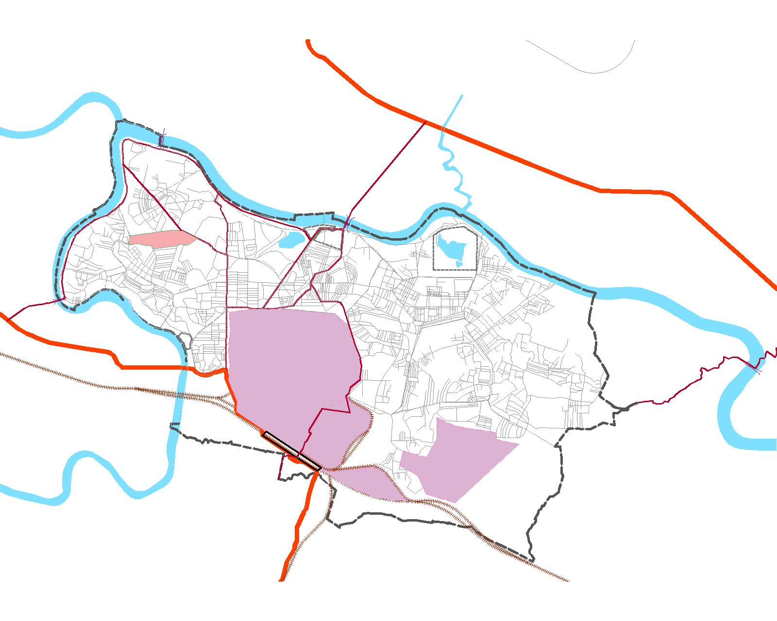
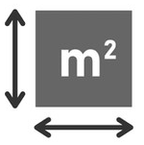








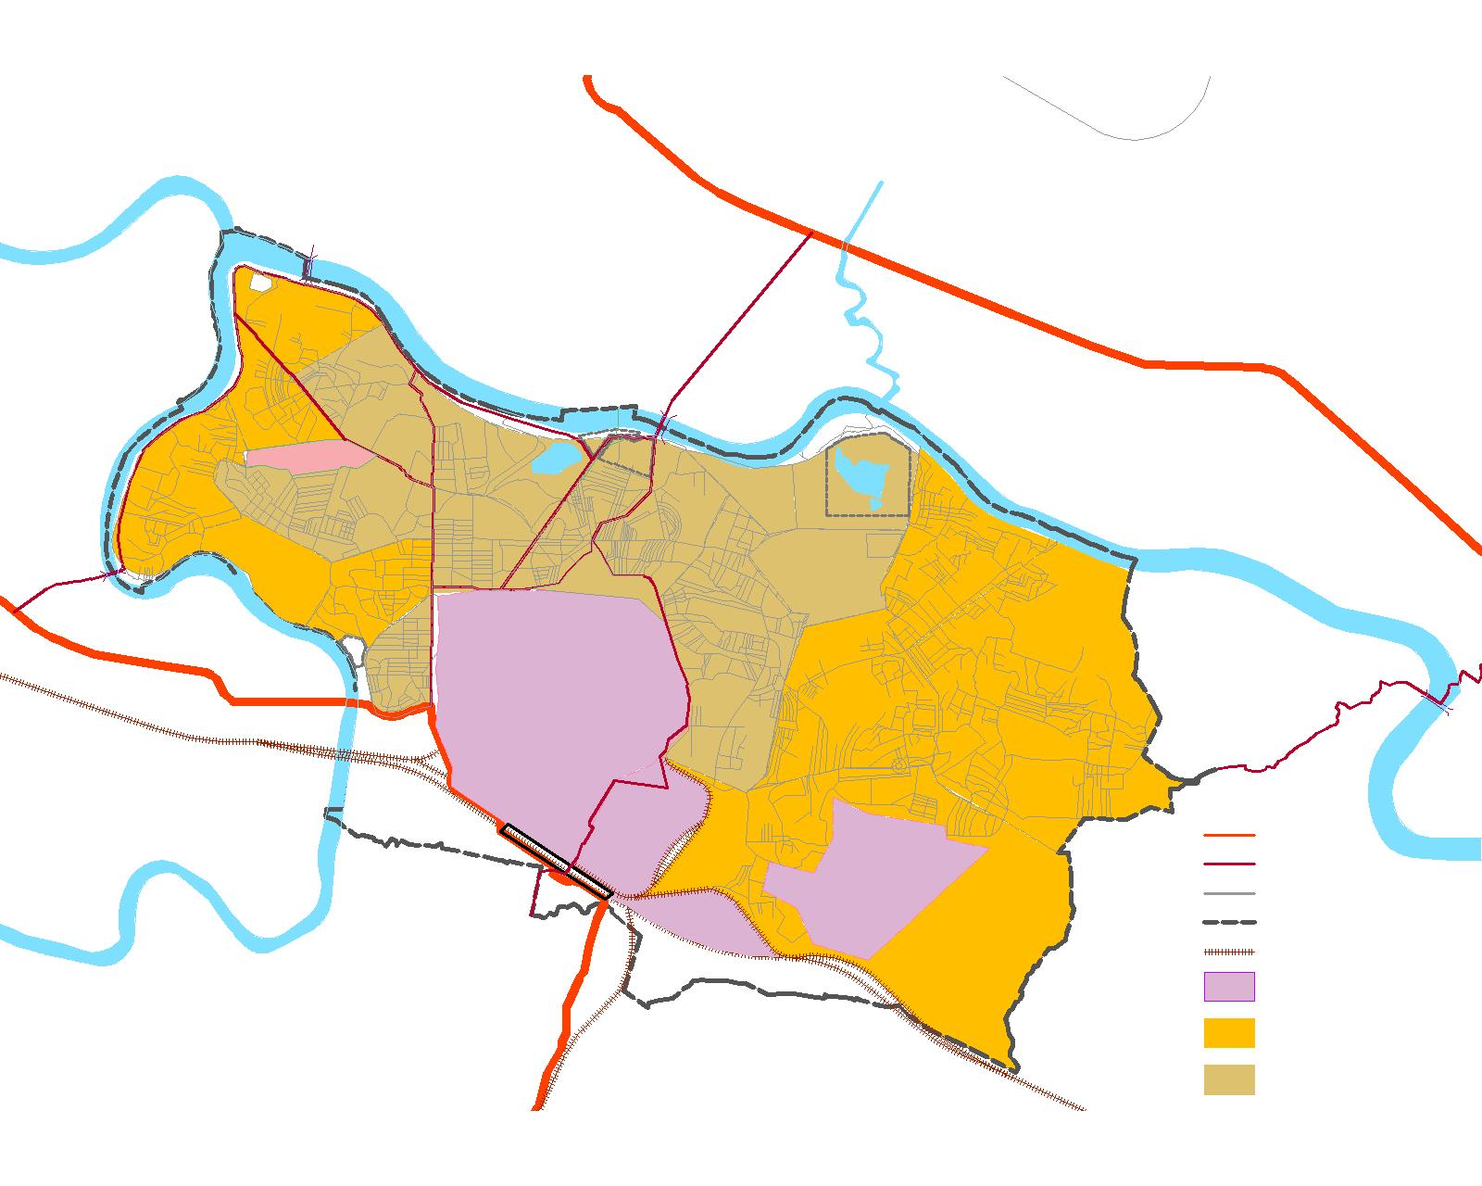


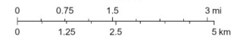
GEOGRAPHICAL SCOPE OF STUDY AREA(JNAC)
DIMNA LAKE
JNAC
(Jamshedpur Notified Area Committee)
TO RANCHI
FROM DIMNA LAKE
DOMUHANI
MANGO
64 Sq.Km. (TUISL)
DIMNA ROAD
ADITYAPUR
RIVER PUMP HOUSE
SONARI AERODROME
NORTHERN
TOWN
WTP
KHARKAI RIVER
677350 (Census 2011)
ULIYAN
BARA
STP
SUVERNREKHA
TO KOLKATA
SAKCHI
AGRICO
BARIDIH
TO KANDRA
BIRSANAGAR
KHARKAI
STP
BISTUPUR
TATA STEEL
139097 (Census 2011)
TO CHAKRADHARPUR
BURMAMINES
NILDIH
TATA NAGAR STATION
₹83,592 (NSDP Data’20)
JUGSALAI
TATA MOTORS
LEGEND
NATIONAL HIGHWAY
MAJOR CONNECTOR ROADS
SCALE:
NEIGHBOURHOOD ROADS
524 KM(TUISL)
JNAC ADMINISTRATIVE BOUNDARY
TO JHARGRAM
RAILWAY LINE
INDUSTRIAL AREA
(Source: udhd,GoJ;TUISL)
DISSERTATION & PLANNING SEMINAR
AR751:THESIS/DISSERTATION
TOPIC: Low-Carbon Water Utility & Municipal Waste Management plan for JNAC, Jamshedpur
RAM KUMAR , MUP/10002/23
SEM-IV , MUP 2023-25
19

Slide 20
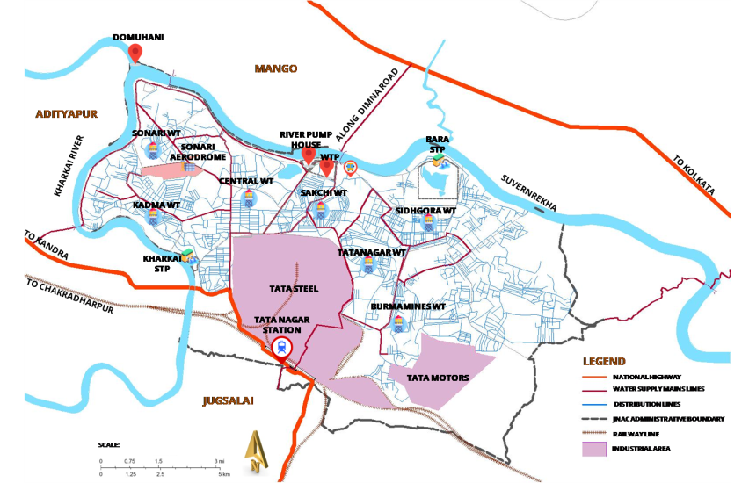
SOURCE OF WATER SUPPLY & CHARACTERISTICS
WATER SOURCES:
SUVERNREKHA RIVER(PERENNIAL RIVER)
KHARKAI RIVER(PERENNIAL RIVER)
DIMNA LAKE
(Source: TUISL)
RIVER WATER FLOW & ABSTRACTION FOR SUVERNREKHA AT JAMSHEDPUR:
 | POST MONSOON | WINTER | SUMMER
RIVER FLOWS AT JSR. | 9.40 cum/sec | 4.50 cum/sec | 5.93 cum/sec
WATER PICK UP | 2.78 cum/sec | 2.666 cum/sec | 2.76 cum/sec
% Age | 29.6 | 59.1 | 46.5
(Source: TUISL)
RIVER WATER QUALITY FOR SUVERNREKHA AT MANGO, JAMSHEDPUR:
(Source: udhd,GoJ;TUISL)
 | TEMP | pH | DO(mg/l) | BOD(mg/l) | COD(mg/l) | Total Hard. (mg/l) | Ca++(mg/l) | Mg++(mg/l) | Alk. (mg/l) | Cond. | Fuoride(mg/l) | Sulphate(mg/l) | Na(mg/l) | K(mg/l) | no3(mg/l) | TS(mg/l) | TSS(mg/l) | TDS(mg/l) | Turbidity NTU. | cl(mg/l)
At Mango,JSR | 25 | 7.6 | 5.5 | 3.2 | 32 | 178 | 41.6 | 18.05 | 112 | 392 | 0.84 | 34.82 | 4.0 | 1.2 | 5.6 | 400 | 134 | 276 | 18 | 42
(Source: TUISL)
DISSERTATION & PLANNING SEMINAR
AR751:THESIS/DISSERTATION
TOPIC: Low-Carbon Water Utility & Municipal Waste Management plan for JNAC, Jamshedpur
RAM KUMAR , MUP/10002/23
SEM-IV , MUP 2023-25
20

Slide 21
WATER SUPPLY SCHEME
WATER SOURCES: SUBARBREKHA RIVER & KHARKAI RIVER
NEW RIVER PUMP HOUSE
OLD RIVER PUMP HOUSE
195 MLD WTP AT WATERWORKS
BURMA MINES
WATER ESR(7.5 MLD)
C
O
N
S
U
M
E
R
S
KADMA
WATER ESR(7.5MLD)
16 MLD
KHARKAI STP
CLARIFIED WATER FOR INDUSTRIAL USE
RAW
WATER FOR INDUSTRIAL USE
WATER SOURCE:
DIMNA RESERVOIR
(3500 MILLION LITRES)
SAKCHI
WATER ESR(10MLD)
SEWAGE PUMPING STATIONS(8)
CENTRAL
WATER ESR(7.5MLD)
SIDHGORA
WATER ESR(7.5MLD)
45 MLD
BARA STP
SONARI
WATER ESR(7.5MLD)
WATER SUPPLY MAINS
22MLD
RECYCLED TO STEEL WORKS
DISTRIBUTION LINE
TATANAGAR
WATER ESR(10MLD)
WASTEWATER COLLECTION
Fig16: water supply scheme of JNAC
(Source: TSUISL)
DISSERTATION & PLANNING SEMINAR
AR751:THESIS/DISSERTATION
TOPIC: Low-Carbon Water Utility & Municipal Waste Management plan for JNAC, Jamshedpur
RAM KUMAR , MUP/10002/23
SEM-IV , MUP 2023-25
21

Slide 22
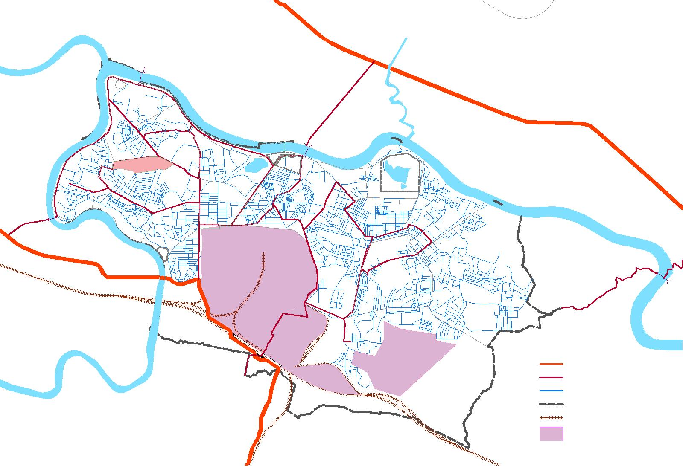



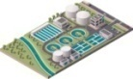








WATER SUPPLY INFRASTRUCTURE OF STUDY AREA(JNAC)
FROM DIMNA LAKE
160KM. (TUISL)
DOMUHANI
TO RANCHI
440KM. (TUISL)
MANGO
CONVENTIONAL 230 MLD PLANT IN 6.5 ACRES (TUISL)
ADITYAPUR
ALONG DIMNA ROAD
07 WATER TOWER IN NO.; 50MLD CAPACITY(TUISL)
SONARI WT
RIVER PUMP HOUSE
BARA
STP
SONARI AERODROME
WTP
KHARKAI RIVER
TO KOLKATA
CENTRAL WT
SAKCHI WT
SUVERNREKHA
KADMA WT
SIDHGORA WT
TO KANDRA
TATANAGAR WT
KHARKAI
STP
TO CHAKRADHARPUR
TATA STEEL
BURMAMINES WT
TATA NAGAR STATION
LEGEND
TATA MOTORS
NATIONAL HIGHWAY
JUGSALAI
WATER SUPPLY MAINS LINES
DISTRIBUTION LINES
JNAC ADMINISTRATIVE BOUNDARY
SCALE:
RAILWAY LINE
INDUSTRIAL AREA
(Source: udhd,GoJ;TUISL)
TO JHARGRAM
DISSERTATION & PLANNING SEMINAR
AR751:THESIS/DISSERTATION
TOPIC: Low-Carbon Water Utility & Municipal Waste Management plan for JNAC, Jamshedpur
RAM KUMAR , MUP/10002/23
SEM-IV , MUP 2023-25
22

Slide 23
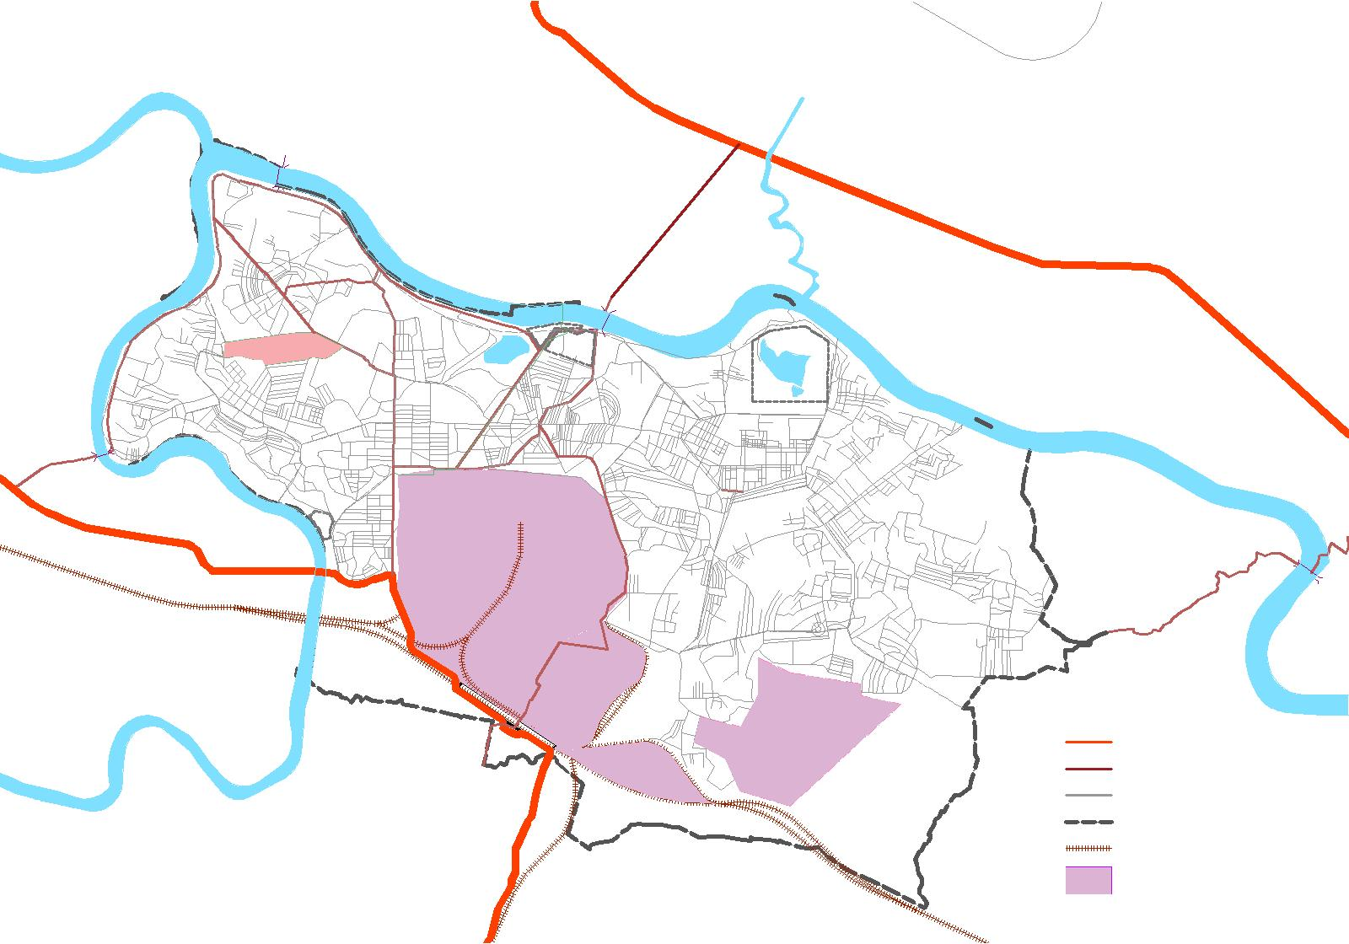



WASTEWATER INFRASTRUCTURE OF STUDY AREA(JNAC)
TO RANCHI
BARA- 45 MLD CONVENTIONAL
LAGOON TYPE STP (TUISL)
FROM DIMNA LAKE
DOMUHANI
MANGO
KHARKAI- 16 MLD ASP
TYPE STP (TUISL)
ADITYAPUR
ALONG DIMNA ROAD
08 PUMPING STATION (TUISL)
05
04
350 KM (TUISL)
KHARKAI RIVER
SONARI AERODROME
06
03
BARA
STP
SUVERNREKHA
TO KOLKATA
S.NO | SEWAGE PUMPING STATION
01. | BARIDIH SEWAGE PUMPING STATION
02. | BARA SEWAGE PUMPING STATION
03. | BHUIYANDIH SEWAGE PUMPING STATION
04. | NORTHERN(CHS) SEWAGE PUMPING STATION
05. | SONARI SEWAGE PUMPING STATION
06. | NEW ULIYAN SEWAGE PUMPING STATION
07. | OLD ULIYAN SEWAGE PUMPING STATION
08. | BURMAMINES SEWAGE PUMPING STATION
02
07
01
TO KANDRA
KHARKAI
STP
TATA STEEL
TO CHAKRADHARPUR
BURMAMINES WT
TATA NAGAR STATION
08
LEGEND
TATA MOTORS
NATIONAL HIGHWAY
JUGSALAI
CONNECTOR ROADS
COLLECTION LINES
JNAC ADMINISTRATIVE BOUNDARY
SCALE:
RAILWAY LINE
INDUSTRIAL AREA
(Source: udhd,GoJ;TUISL)
TO JHARGRAM
DISSERTATION & PLANNING SEMINAR
AR751:THESIS/DISSERTATION
TOPIC: Low-Carbon Water Utility & Municipal Waste Management plan for JNAC, Jamshedpur
RAM KUMAR , MUP/10002/23
SEM-IV , MUP 2023-25
23

Slide 24






DATA COLLECTION : WATER SUPPLY & OTHER METRICS
WATER SUPPLY METRICS
DOMUHANI
POPULATION | 700000(2019)
NO. OF CONNECTIONS | 66000
WATER SUPPLY PER PERSON | 170 lpcd
COVERAGE | 85%
NRW | 10%
WATER SUPPLY MAINS(length) | 160 KM
OLD(MAINS) | 100KM
NEW (MAINS) | 60 KM
WATER SUPPLY DISTRIBUTION | 440KM
SEWERAGE COLLECTION NETWORK | 350KM
SEWAGE GENERATED | 119.60 MLD
SEWAGE TREATED | 61 MLD
RECYCLED WATER USED | 22 MLD
POWER CONSUMPTION PER MLD | 274 KWh/MLD
MANGO
ADITYAPUR
ALONG DIMNA ROAD
SONARI WT
RIVER PUMP HOUSE
BARA
STP
SONARI AERODROME
WTP
KHARKAI RIVER
TO KOLKATA
CENTRAL WT
SAKCHI WT
SUVERNREKHA
KADMA WT
SIDHGORA WT
TO KANDRA
KHARKAI
STP
TATANAGAR WT
TO CHAKRADHARPUR
TATA STEEL
TATA NAGAR STATION
BURMAMINES WT
LEGEND
TATA MOTORS
NATIONAL HIGHWAY
JUGSALAI
WATER SUPPLY MAINS LINES
DISTRIBUTION LINES
JNAC ADMINISTRATIVE BOUNDARY
SCALE:
RAILWAY LINE
INDUSTRIAL AREA
(Source: udhd,GoJ;TUISL)
DISSERTATION & PLANNING SEMINAR
AR751:THESIS/DISSERTATION
TOPIC: Low-Carbon Water Utility & Municipal Waste Management plan for JNAC, Jamshedpur
RAM KUMAR , MUP/10002/23
SEM-IV , MUP 2023-25
24

Slide 25
WATER SUPPLY &CONSUMPTION PATTERN
WATER CONSUMPTION:
WATER CONSUMPTION | (2018-19) | (2019-20)
Domestic Consumption (as drinking water Supplied to township) | 2,05,430 m3/day | 2,05,100 m3/day
WATER CONSUMPTION | (2021-22) | (2022-23)
Domestic Consumption (as drinking water Supplied to township) | 2,03,923 m3/day | 2,05,100 m3/day
WATER TREATMENT:
WATER TREATMENT AT WTP | (2018-19) | (2019-20)
Water Treatment at WTP | 62,47,126 m3/month | 62,55,550 m3/month
WATER TREATMENT AT WTP | (2021-22) | (2022-23)
Water Treatment at WTP | 64,78,150 m3/month | 65,42,108 m3/month
(Source: TSUISL)
DISSERTATION & PLANNING SEMINAR
AR751:THESIS/DISSERTATION
TOPIC: Low-Carbon Water Utility & Municipal Waste Management plan for JNAC, Jamshedpur
RAM KUMAR , MUP/10002/23
SEM-IV , MUP 2023-25
25

Slide 26
WATER SUPPLY PROCESS &CHEMICALS USED
DETAILS OF CHEMICALS USED :
CHEMICAL USED | SERVICES | CONSUMPTION OF RAW MATERIAL(TONNES)
 |  | (2018-2019) | (2019-2020) | (2021-22) | (2022-23)
SOLID ALUM | WATER TREATMENT | 215.748 | 818.04 | 164 | 175
LIQUID PAC |  | 785.609 | 631.01 | 600 | 555
LIQUID CHLORINE |  | 238.762 | 271.55 | 210 | 502
POWDER PAC |  | 56.125 | 89.45 | 90 | 210
BLEACHING POWDER |  | 14.175 | 1.9 | 30 | 80
POLYELECTROLYTE |  | 2.73 | 27.9 | 1 | 13.5
(Source: TSUISL)
WIGHTED MEAN VALUES FOR CHEMICALS USED(5 yrs) :
CONVENTIONAL PROCESS USED:
CHEMICAL USED | usage/m3 of water
SolidAlum | 4.57 mg/m3
LiquidPAC | 8.576 mg/m3
LiquidChlorine | 4.076 mg/m3
Powder PAC | 1.4859 mg/m3
Bleaching Powder | 0.42044 mg/m3
Polyelectrolyte | 0.150503 mg/m3
Raw Water Intake → Coagulation (Alum, PAC, Lime) → Sedimentation (Alum, Polyelectrolytes) → Filtration → Storage (Chlorine).
:pH Stabilization (Lime, Soda Ash).
DISSERTATION & PLANNING SEMINAR
AR751:THESIS/DISSERTATION
TOPIC: Low-Carbon Water Utility & Municipal Waste Management plan for JNAC, Jamshedpur
RAM KUMAR , MUP/10002/23
SEM-IV , MUP 2023-25
26

Slide 27
WATER BALANCE DIAGRAM OF STUDY AREA(JNAC)
RAW WATER SOURCE
DEMAND
138.04 MLD
DIMNA
RESERVOIR
RESIDENTIAL DEMAND
109.96 MLD
SUVERNREKHA RIVER
UNTREATED
68.20 MLD
SUPPLY
204 MLD
COMMERCIAL& INSTITUTIONAL DEMAND
11 MLD
230 MLD CAPACITY WTP AT WATERWORKS
WASTEWATER
119.20 MLD
LESS NRW(10%)
182.7 MLD
0.8*138+10% INFILTRATION
119.20 MLD
FIRE DEMAND
16.98 MLD
TREATMENT CAPACITY
61 MLD
SUVERNREKHA RIVER
KHARKAI
RIVER
HORTICULTURE
0.1 MLD
TREATED=51 MLD
16 MLD
KHARKAI STP
RAW WATER SOURCE
RAW WATER SOURCE
550 WATER LAMPOSTS
0.1 MLD
45 MLD
BARA STP
22MLD
RECYCLED TO STEEL WORKS
WATER TOWERS(07 NO.)
TOTAL CAPACITY- 50 MLD
(Source: Author)
RESERVE BALANCE
44.66 MLD
DISSERTATION & PLANNING SEMINAR
AR751:THESIS/DISSERTATION
TOPIC: Low-Carbon Water Utility & Municipal Waste Management plan for JNAC, Jamshedpur
RAM KUMAR , MUP/10002/23
SEM-IV , MUP 2023-25
27

Slide 28





HOLDING PATTERN OF STUDY AREA(JNAC)
JNAC
(Jamshedpur Notified Area Committee)
TO RANCHI
FROM DIMNA LAKE
DOMUHANI
64.00 Sq.Km.(JNAC)
MANGO
677350 (Census 2011)
DIMNA ROAD
ADITYAPUR
RIVER PUMP HOUSE
SONARI AERODROME
NORTHERN
TOWN
WTP
TATA COMMAND AREA
KHARKAI RIVER
ULIYAN
BARA
STP
SUVERNREKHA
TO KOLKATA
SAKCHI
AGRICO
37.20 Sq.Km. (TUISL)
BARIDIH
TO KANDRA
BIRSANAGAR
BISTUPUR
110000 (TUISL)
KHARKAI
STP
TATA STEEL
TO CHAKRADHARPUR
BURMAMINES
NILDIH
SUB-LEASED AREA
TATA NAGAR STATION
LEGEND
NATIONAL HIGHWAY
28.80 Sq.Km. (TUISL)
TATA MOTORS
MAJOR CONNECTOR ROADS
JUGSALAI
NEIGHBOURHOOD ROADS
JNAC ADMINISTRATIVE BOUNDARY
RAILWAY LINE
567350 (TUISL)
INDUSTRIAL AREA
SCALE:
SUB-LEASED AREA UNDER JNAC
(Source: udhd,GoJ;TUISL)
TO JHARGRAM
TATA COMMAND AREA
DISSERTATION & PLANNING SEMINAR
AR751:THESIS/DISSERTATION
TOPIC: Low-Carbon Water Utility & Municipal Waste Management plan for JNAC, Jamshedpur
RAM KUMAR , MUP/10002/23
SEM-IV , MUP 2023-25
28

Slide 29



BASTIS WITHIN STUDY AREA(JNAC)
DIMNA LAKE
BASTIS IN JNAC
(Jamshedpur Notified Area Committee)
TO RANCHI
FROM DIMNA LAKE
S.No. | Name | Area(sq.Km.) | Population
01. | GurudwaraBasti | 0.32 | 3481
02. | HarijanBasti,Dhatkhedi | 0.46 | 5004
03. | Ranikudar | 0.29 | 3155
04. | NewRanikudar | 0.36 | 3916
05. | SonariBasti | 0.31 | 3372
06. | KhutadihBasti | 0.45 | 4895
07. | KumharpadaBasti | 0.26 | 2828
08. | KasidihBasti | 0.31 | 3372
09. | HumePipe Basti | 0.23 | 2502
10. | BhalubashaBasti | 0.28 | 3046
11. | SitaramderaBasti | 0.37 | 4025
12. | BaridihBasti | 0.41 | 4460
13. | ToiladungriBasti | 0.25 | 2720
14. | GadabashaBasti | 0.29 | 3155
15. | EastPlantBasti | 0.33 | 3590
16. | Namda Basti | 0.43 | 4678
17. | MonifitBasti | 0.27 | 2937
 | Total | 5.62 | 61137
DOMUHANI
5
MANGO
DIMNA ROAD
ADITYAPUR
4
KHARKAI RIVER
SUVERNREKHA
TO KOLKATA
3
9
10
2
12
TO KANDRA
3
6
11
7
TATA STEEL
8
16
TO CHAKRADHARPUR
15
17
13
TATA NAGAR STATION
JUGSALAI
TATA MOTORS
LEGEND
NATIONAL HIGHWAY
MAJOR CONNECTOR ROADS
(Source: TSUISL,Census 2011)
SCALE:
NEIGHBOURHOOD ROADS
JNAC ADMINISTRATIVE BOUNDARY
TO JHARGRAM
RAILWAY LINE
(Source: udhd,GoJ;TUISL)
INDUSTRIAL AREA
DISSERTATION & PLANNING SEMINAR
AR751:THESIS/DISSERTATION
TOPIC: Low-Carbon Water Utility & Municipal Waste Management plan for JNAC, Jamshedpur
RAM KUMAR , MUP/10002/23
SEM-IV , MUP 2023-25
29

Slide 30
DEMOGRAPHIC COMPOSITION OF STUDY AREA(JNAC)
DISSERTATION & PLANNING SEMINAR
AR751:THESIS/DISSERTATION
TOPIC: Low-Carbon Water Utility & Municipal Waste Management plan for JNAC, Jamshedpur
RAM KUMAR , MUP/10002/23
SEM-IV , MUP 2023-25
30

Slide 31
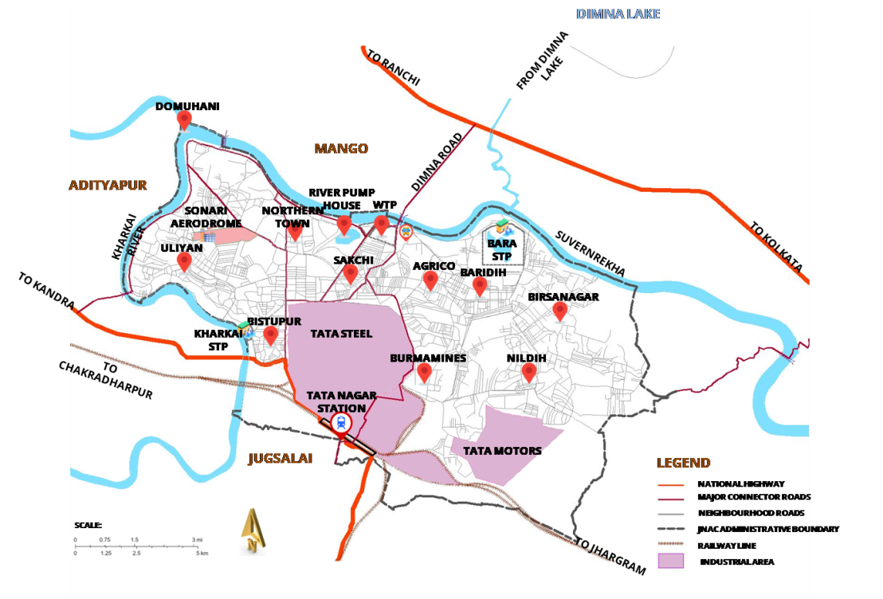
POPULATION PROJECTION OF STUDY AREA(JNAC)
POPULATION PROJECTION FOR JNAC(2001 TO 2051)
YEAR | ARITHMETIC GROWTH | GEOMETRIC GROWTH | LOGISTIC GROWTH
2001 | 6,12,534 | 6,12,534 | 6,12,534
2011 | 6,77,350 | 6,77,350 | 6,77,350
2021 | 7,42,166 | 7,49,024 | 7,06,955
2031 | 8,06,982 | 8,28,283 | 7,36,032
2041 | 8,71,798 | 9,15,929 | 7,64,450
2051 | 9,36,614 | 10,12,849 | 7,92,093
 | 6,481 per year (constant increase) | 1.02% per year (compounded) | 1.02% per year
POPULATION PROJECTIONS OF BASTI AREA(17 slum areas)
YEAR | ARITHMETIC GROWTH | GEOMETRIC GROWTH | LOGISTIC GROWTH
2001 | 59,314 | 59,314 | 59,314
2011 | 61,137 | 61,137 | 60,194
2021 | 62,960 | 63,016 | 61,073
2031 | 64,784 | 64,954 | 61,951
2041 | 66,607 | 66,950 | 62,827
2051 | 68,430 | 69,008 | 63,701
A(POPULATION) = B+C+D
A
B
C
D
YEAR | JNAC(Pop.) | TATA COMMAND AREA(Pop.) | SUB-LEASED AREA(Pop.) | BASTIS (Pop.)
2019 | 701072 | 110000 | 598112 | 62960
2030 | 806982 | 120000 | 625031 | 61951
LOGISTIC GROWTH HAS BEEN TAKEN FOR PROJECTED POPULATION FOR 2019 &2030.
REASON: Urban constraints (land, jobs, housing) are slowing growth, the Logistic estimate (701,072) is more realistic.
DISSERTATION & PLANNING SEMINAR
AR751:THESIS/DISSERTATION
TOPIC: Low-Carbon Water Utility & Municipal Waste Management plan for JNAC, Jamshedpur
RAM KUMAR , MUP/10002/23
SEM-IV , MUP 2023-25
31

Slide 32
ANALYSIS: WATER CYCLE
AR751:THESIS/DISSERTATION
TOPIC: Low-Carbon Water Utility & Municipal Waste Management plan for JNAC, Jamshedpur
RAM KUMAR , MUP/10002/23
SEM-IV , MUP 2023-25

Slide 33
ANALYSIS WORKFLOW: BASELINE CARBON FOOTPRINT ASSESSMENT
DATA COLLECTION
(TUISL,JNAC)
07
FUNCTIONAL UNIT
GOAL DEFINITION
BASELINE CARBON FOOTPRINT ASSESSMENT LCA USING OpenLCA 3.0 & Ecoinvent database 3.11
REFERENCE FLOWS
ASSESSMENT PARAMETERS
SCOPE DEFINITION
SPATIO-TEMPORAL BOUNDARY
TREND ANALYSIS & GAP IDENTIFICATION
(CURRENT SCENARIO w.r.t. NDC & LT-LEDS)
INPUT FLOWS(RESOURCES)
INVENTORY
ANALYSIS(LCI)
DATA ANALYSIS
(USING OpenLCA 3.0 software and Ecoinvent 3.11 Database)
OUTPUT FLOWS(EMISSION.PRODUCTS)
SBT BASED TARGET SETTING
(SHORT TERM & LONG TERM TARGET)
IMPACT ASSESSMENT (LCIA)
IMPACT CATEGORIES
LCI FLOW ALLOCATION
SCENARIO GENERATION & ANALYSIS
USING OpenLCA
DISSERTATION & PLANNING SEMINAR
AR751:THESIS/DISSERTATION
TOPIC: Low-Carbon Water Utility & Municipal Waste Management plan for JNAC, Jamshedpur
RAM KUMAR , MUP/10002/23
SEM-IV , MUP 2023-25
33

Slide 34
GOAL: BASELINE CARBON FOOTPRINT ASSESSMENT
GOAL DEFINITION:
APPROACH: CRADLE TO GRAVE APPROACH
GOAL
TO EVALUATE THE CARBON FOOTPRINT (CF) of WATER CYCLE( WHICH INCLUDES STAGES OF WATER ABSTRACTION,WATER TREATMENT,WATER SUPPLY, WASTEWATER COLLECTION & WASTERWATER TREATMENT) for MUNICIPALITY of JNAC(JAMSHEDPUR NOTIFIED AREA COMMITTEE) WITH YEAR 2019 AS BASELINE YEAR.
SYSTEM BOUNDARY DEFINITION:
SYSTEM BOUNDARY
WATER ABSTRACTION
(WA)
WATER TREATMENT
(WT)
WATER SUPPLY & DISTRIBUTION
(WS)
WASTEWATER COLLECTION
(WC)
WASTEWATER TREATMENT
(WWT)
RECYCLED
WATER
RAW WATER
(Source: Boldrin et.al.2022, Perez et.al.2018)
FUNCTIONAL UNIT DEFINITION:
FUNCTIONAL UNIT
WATER CYCLE
1 M3 OF WATER FOR CONSUMPTION HAS BEEN TAKEN AS THE FUNCTIONAL UNIT TO ASSESS & COMPARE ALTERNATIVE SCENARIOS. ALSO,FU TAKES INTO CONSIDERATION LOSS OF POTABLE WATER(NRW).
(Source: Boldrin et.al.2022, Perez et.al.2018)
DISSERTATION & PLANNING SEMINAR
AR751:THESIS/DISSERTATION
TOPIC: Low-Carbon Water Utility & Municipal Waste Management plan for JNAC, Jamshedpur
RAM KUMAR , MUP/10002/23
SEM-IV , MUP 2023-25
34

Slide 35
REFERENCE FLOW DEFINITION:BASELINE CARBON FOOTPRINT ASSESSMENT
REFERNCE FLOW DEFINITION
APPROACH: CRADLE TO GRAVE APPROACH
REFERENCE FLOW
WATER CYCLE
THE REFERENCE FLOW FOR THE WATER CYCLE IN A LIFE CYCLE ASSESSMENT (LCA) FRAMEWORK REPRESENTS THE FLOW OF RESOURCES AND EMISSIONS THROUGH EACH STAGE OF THE WATER CYCLE.
(Source: Boldrin et.al.2022, Perez et.al.2018)
ELECTRICITY(kWh)
LIME(mg)
SODIUM HYPOCHLORITE(g)
LIQUID CHLORINE(g)
ALUMINIUM SULFATE(mg)
CHLORINE GAS(g)
ELECTRICITY(kWh)
FOSSIL FUELS(LITRES)
SODIUM LAURYL SULPHATE(g)
SODIUM HYPOCHLORITE(g)
CHLORINE GAS(g)
ELECTRICITY(kWh)
FOSSIL FUEL(litres)
ACTIVATED CARBON(Kg)
WATER(Kg)
ELECTRICITY(kWh)
FOSSIL FUELS(LITRES)
SODIUM HYPOCHLORITE(g)
CHLORINE GAS(g)
ELECTRICITY(kWh)
FOSSIL FUELS(LITRES)
SODIUM LAURYL SULPHATE(g)
WATER ABSTRACTION
(WA)
.......m3
WATER TREATMENT
(WT)
.......m3
WATER SUPPLY & DISTRIBUTION
(WS)
.......m3
WASTEWATER COLLECTION
(WC)
.......m3
WASTEWATER TREATMENT
(WWT)
1 m3
EMISSIONS TO WATER
BOD5(mg)
COD(g)
ALUMINIUM COMPOUND(g)
EMISSIONS TO SOIL
TOTAL ALUMINIUM (g)
TOTAL MANGANESE(g)
TOTAL IRON(g)
EMISSIONS TO AIR
CH4(g)
EMISSIONS TO SOIL
ARSENIC(mg)
COPPER(mg)
CHROMIUM(mg)
FINAL WASTE FLOWS
SLUDGE(Kg)
(Source: Boldrin et.al.2022, Perez et.al.2018)
DISSERTATION & PLANNING SEMINAR
AR751:THESIS/DISSERTATION
TOPIC: Low-Carbon Water Utility & Municipal Waste Management plan for JNAC, Jamshedpur
RAM KUMAR , MUP/10002/23
SEM-IV , MUP 2023-25
35

Slide 36
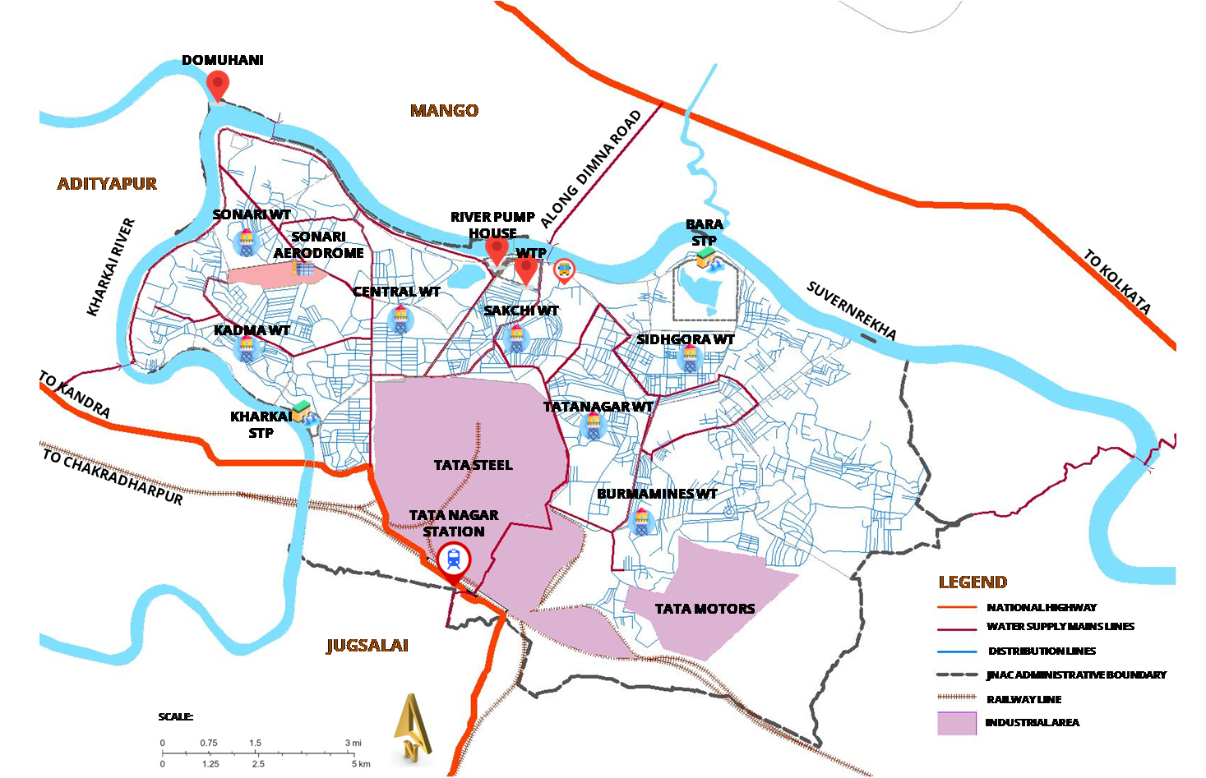
SCOPE DEFINITION: BASELINE CARBON FOOTPRINT ASSESSMENT
SCOPE
TEMPORAL SCOPE
TO EVALUATE THE CARBON FOOTPRINT (CF) of WATER CYCLE for MUNICIPALITY of JNAC(JAMSHEDPUR NOTIFIED AREA COMMITTEE) WITH YEAR 2019 AS BASELINE.
GEOGRAPHICAL SCOPE
TO EVALUATE THE CARBON FOOTPRINT (CF) of WATER CYCLE for MUNICIPALITY of JNAC(JAMSHEDPUR NOTIFIED AREA COMMITTEE) WITHIN THE MUNICIPAL BOUNDARY OF JNAC.
DISSERTATION & PLANNING SEMINAR
AR751:THESIS/DISSERTATION
TOPIC: Low-Carbon Water Utility & Municipal Waste Management plan for JNAC, Jamshedpur
RAM KUMAR , MUP/10002/23
SEM-IV , MUP 2023-25
36

Slide 37
PARAMETERS(BAU): BASELINE CARBON FOOTPRINT ASSESSMENT
PARAMETER CATEGORY | PARAMETER | DESCRIPTION | UNIT
Water Abstraction | Water source availability | Availability of water in surface or groundwater sources. | 518400 m³/day
 | Abstraction rate | Rate of water withdrawn from natural sources. | 256000 m³/day
 | Seasonal variation in source flow | Changes in water availability across seasons. | 60 % change
 | Pumping energy consumption | Energy required for pumping water from the source. | 2.02kWh/m³
 | Source water quality | Quality indicators of source water (e.g., turbidity, pH, contaminants). | As table data
Water Treatment | Treatment efficiency | Efficiency of processes like filtration, disinfection, and sedimentation. | 95%
 | Chemical usage in treatment | Amount of chemicals (e.g., chlorine, alum) used in treatment. | As table data
 | Treatment plant capacity | Maximum water treatment capacity of the plant. | 230000m³/day
 | Sludge generation | Amount of sludge produced per unit of water treated. | 0.09kg/m³
 | Energy consumption in treatment | Energy used for treatment processes per unit of water treated. | 0.23kWh/m³
Water Supply | Distribution network efficiency | Efficiency of the water supply distribution system (leakage rates). | 90%
 | Leakage rate | Water lost due to leaks in the supply network. | 10%
 | Pressure in supply network | Pressure maintained in distribution pipes. | 60psi
 | Customer coverage | Proportion of customers with water meters. | 85%
 | Energy consumption for distribution | Energy needed for distributing water through the network. | 2.55kWh/m³
Wastewater Collection | Collection efficiency | Efficiency of wastewater collection from households and businesses. | 100%
 | Infiltration and inflow rates | Rate of groundwater or stormwater entering the sewage system. | 10%
 | Sewer network capacity | Maximum capacity of the sewage collection system. | 130000m³/day
 | Pumping energy for wastewater collection | Energy consumed in pumping wastewater through collection network. | 0.217kWh/m³
Wastewater Treatment | Treatment efficiency (BOD/COD removal) | Efficiency in removing contaminants like BOD/COD. | 80%
 | Chemical usage for treatment | Amount of chemicals used in wastewater treatment (e.g., coagulants, disinfectants). | As table data
 | Sludge production | Amount of sludge generated per unit of wastewater treated. | 0.19kg/m³
 | Energy consumption in treatment | Energy used for wastewater treatment processes per unit of wastewater treated. | 1.33kWh/m³
 | Treated effluent quality | Quality indicators of treated effluent (e.g., BOD, nitrogen, phosphorus levels). | As table
GRID ENERGY MIX(NON RENEWABLE TO RENEWABLE ENERGY)-70:30
ELECTRICITY SUPPLY EFFICIENCY-99.32%
DISSERTATION & PLANNING SEMINAR
AR751:THESIS/DISSERTATION
TOPIC: Low-Carbon Water Utility & Municipal Waste Management plan for JNAC, Jamshedpur
RAM KUMAR , MUP/10002/23
SEM-IV , MUP 2023-25
37

Slide 38
INVENTORY ANALYSIS: BASELINE CARBON FOOTPRINT ASSESSMENT
ELECTRICITY(kWh)-0.23kWH
LIME(mg)
SODIUM HYPOCHLORITE(g)-3.7g
LIQUID CHLORINE(g)-2.575g
ALUMINIUM SULFATE(mg)-5.5mg
CHLORINE GAS(g)-3.08g
ELECTRICITY(kWh)-2.55kWH
FOSSIL FUELS(LITRES)-0.008l
SODIUM HYPOCHLORITE(g)-2.5g
CHLORINE GAS(g)-0.98g
ELECTRICITY(kWh)-1.33kWH
FOSSIL FUELS(LITRES)-
SODIUM LAURYL SULPHATE(g)-52.8mg
SODIUM HYPOCHLORITE(g)-3.7g
CHLORINE GAS(g)-3.45g
ELECTRICITY(kWh)-2.0205kWH
FOSSIL FUEL(litres)-0.005l
ACTIVATED CARBON(Kg)-0.21g
Pipes-0.00186 kg/m3
ELECTRICITY(kWh)-0.217kWH
FOSSIL FUELS(LITRES)-0.003l
SODIUM LAURYL SULPHATE(g)-55.03g
WATER ABSTRACTION
(WA)
1.4619 m3
WATER TREATMENT
(WT)
1.3888 m3
WATER SUPPLY & DISTRIBUTION
(WS)
1.2499 m3
WASTEWATER COLLECTION
(WC)
1.099 m3
WASTEWATER TREATMENT
(WWT)
1 m3
EMISSIONS TO WATER
BOD5(mg)-180mg
COD(g)-1.2g
ALUMINIUM COMPOUND(g)-1.65g
EMISSIONS TO SOIL
TOTAL ALUMINIUM (g)-38.63g
TOTAL MANGANESE(g)-1.79g
TOTAL IRON(g)-4.83g
WATER LOSS
0.138 m3
EMISSIONS TO AIR
CH4(g)-0.00964g
EMISSIONS TO SOIL
ARSENIC(mg)-0.1mg
COPPER(mg)-3.4mg
CHROMIUM(mg)-5.4mg
FINAL WASTE FLOWS
SLUDGE(Kg)-0.19kg
(Source: author)
DISSERTATION & PLANNING SEMINAR
AR751:THESIS/DISSERTATION
TOPIC: Low-Carbon Water Utility & Municipal Waste Management plan for JNAC, Jamshedpur
RAM KUMAR , MUP/10002/23
SEM-IV , MUP 2023-25
38

Slide 39
BASELINE LCA:WATER SUPPLY-DETAILS OF RESULT
FUNCTIONAL UNIT: 1m3 OF TAP WATER FOR CONSUMPTION
GEOGRAPHICAL SCOPE: MUNICIPAL BOUNDARY OF JNAC,JAMSHEDPUR
TEMPORAL SCOPE: 2019 IS SELECTED AS A BASELINE YEAR
SOFWARE USED: OpenLCA 2.4
DATABASE : DATA FROM TATA URBAN UTILITIES Ltd. & Ecoinvent 3.10 database
RESULT INFORMATION
PRODUCT SYSTEM: | tap water production, conventional treatment | tap water | APOS, S - JNAC
REFERENCE PROCESS: | tap water production, conventional treatment | tap water | APOS, S
REFERENCE PROCESS LOCATION: | JNAC,India
PRODUCT: | tap water
AMOUNT: | 1.0 m3
IMPACT METHOD: | ReCiPe 2016 v1.03, midpoint (H)
NORMALISATION & WEIGHTING SET:
ALLOCATION METHOD: | process based
CUTOFF: | midpoint
DATE: | 02-02-2025 19:55
DISSERTATION & PLANNING SEMINAR
AR751:THESIS/DISSERTATION
TOPIC: Low-Carbon Water Utility & Municipal Waste Management plan for JNAC, Jamshedpur
RAM KUMAR , MUP/10002/23
SEM-IV , MUP 2023-25
39

Slide 40
BASELINE LCA:WATER SUPPLY-IMPACT RESULT
IMPACT RESULT:
S.NO. | Impact category | Reference unit | Result
1 | Acidification: terrestrial | kg SO2-Eq | 0.00000221
2 | Climate change | kg CO2-Eq | 0.00066543
3 | Ecotoxicity: freshwater | kg 1,4-DCB-Eq | 0.00002660
4 | Ecotoxicity: marine | kg 1,4-DCB-Eq | 0.00003747
5 | Ecotoxicity: terrestrial | kg 1,4-DCB-Eq | 0.00216154
6 | Energy resources: non-renewable, fossil | kg oil-Eq | 0.00016876
7 | Eutrophication: freshwater | kg P-Eq | 0.00000056
8 | Eutrophication: marine | kg N-Eq | 0.00000004
9 | Human toxicity: carcinogenic | kg 1,4-DCB-Eq | 0.00011117
10 | Human toxicity: non-carcinogenic | kg 1,4-DCB-Eq | 0.00097153
11 | Ionising radiation | kBq Co-60-Eq | 0.00001872
12 | Land use | m2*a crop-Eq | 0.00001033
13 | Material resources: metals/minerals | kg Cu-Eq | 0.00000338
14 | Ozone depletion | kg CFC-11-Eq | 0.00000000
15 | Particulate matter formation | kg PM2.5-Eq | 0.00000162
16 | Photochemical oxidant formation: human health | kg NOx-Eq | 0.00000149
17 | Photochemical oxidant formation: terrestrial ecosystems | kg NOx-Eq | 0.00000151
18 | Water use | m3 | 0.00000384
DISSERTATION & PLANNING SEMINAR
AR751:THESIS/DISSERTATION
TOPIC: Low-Carbon Water Utility & Municipal Waste Management plan for JNAC, Jamshedpur
RAM KUMAR , MUP/10002/23
SEM-IV , MUP 2023-25
40

Slide 41
BASELINE LCA:WATER SUPPLY-IMPACT RESULT
Impact due to Climate change(kg CO2-Eq) = 0.00066543 kg CO2-Eq per m3 of water
Daily impact due to climate change = 138.5675 kg CO2-Eq per day
Monthly impact due to climate change = 4157.025 kg CO2-Eq per month
Annual impact due to climate change = 49884.30 kg CO2-Eq per year(2019)
DISSERTATION & PLANNING SEMINAR
AR751:THESIS/DISSERTATION
TOPIC: Low-Carbon Water Utility & Municipal Waste Management plan for JNAC, Jamshedpur
RAM KUMAR , MUP/10002/23
SEM-IV , MUP 2023-25
41

Slide 42
BASELINE LCA:WASTEWATER COLLECTION & TREATMENT-RESULT DETAILS
FUNCTIONAL UNIT: 1m3 OF RECYCLED WATER FOR CONSUMPTION
GEOGRAPHICAL SCOPE: MUNICIPAL BOUNDARY OF JNAC,JAMSHEDPUR
TEMPORAL SCOPE: 2019 IS SELECTED AS A BASELINE YEAR
SOFWARE USED: OpenLCA 2.4
DATABASE : DATA FROM TATA URBAN UTILITIES Ltd. & Ecoinvent 3.10 database
RESULT INFORMATION
PRODUCT SYSTEM: | market for wastewater, uasb | wastewater, average | APOS, S - JNAC
REFERENCE PROCESS: | market for wastewater, uasb | wastewater, average | APOS, S
REFERENCE PROCESS LOCATION: | JNAC,India
PRODUCT: | wastewater, average
AMOUNT: | 1.0 m3
IMPACT METHOD: | ReCiPe 2016 v1.03, midpoint (H)
NORMALISATION & WEIGHTING SET:
ALLOCATION METHOD: | process defaults
CUTOFF: | midpoint
DATE: | 02-02-2025 21:29
DISSERTATION & PLANNING SEMINAR
AR751:THESIS/DISSERTATION
TOPIC: Low-Carbon Water Utility & Municipal Waste Management plan for JNAC, Jamshedpur
RAM KUMAR , MUP/10002/23
SEM-IV , MUP 2023-25
42

Slide 43
BASELINE LCA:WASTEWATER COLLECTION & TREATMENT-IMPACT RESULT
IMPACT RESULT:
S.No. | IMPACT CATEGORY | REFERENCE UNIT | RESULT
1 | Acidification: terrestrial | kg SO2-Eq | 0.00086925
2 | Climate change | kg CO2-Eq | 0.30847441
3 | Ecotoxicity: freshwater | kg 1,4-DCB-Eq | 0.04264042
4 | Ecotoxicity: marine | kg 1,4-DCB-Eq | 0.06493304
5 | Ecotoxicity: terrestrial | kg 1,4-DCB-Eq | 7.46803523
6 | Energy resources: non-renewable, fossil | kg oil-Eq | 0.06145995
7 | Eutrophication: freshwater | kg P-Eq | 0.00340278
8 | Eutrophication: marine | kg N-Eq | 0.00767369
9 | Human toxicity: carcinogenic | kg 1,4-DCB-Eq | 0.17766451
10 | Human toxicity: non-carcinogenic | kg 1,4-DCB-Eq | 2.25235364
11 | Ionising radiation | kBq Co-60-Eq | 0.01147272
12 | Land use | m2*a crop-Eq | 0.00630558
13 | Material resources: metals/minerals | kg Cu-Eq | 0.00610663
14 | Ozone depletion | kg CFC-11-Eq | 0.00000083
15 | Particulate matter formation | kg PM2.5-Eq | 0.00044529
16 | Photochemical oxidant formation: human health | kg NOx-Eq | 0.00071764
17 | Photochemical oxidant formation: terrestrial ecosystems | kg NOx-Eq | 0.00074139
18 | Water use | m3 | 0.00209309
DISSERTATION & PLANNING SEMINAR
AR751:THESIS/DISSERTATION
TOPIC: Low-Carbon Water Utility & Municipal Waste Management plan for JNAC, Jamshedpur
RAM KUMAR , MUP/10002/23
SEM-IV , MUP 2023-25
43

Slide 44
BASELINE LCA:WASTEWATER COLLECTION & TREATMENT-IMPACT RESULT
Impact due to Climate change(kg CO2-Eq) = 0.30847441 kg CO2-Eq per m3 of water
Daily impact due to climate change = 678643.7 kg CO2-Eq per day
Monthly impact due to climate change = 20359311.06 kg CO2-Eq per month
Annual impact due to climate change = 244311732.72 kg CO2-Eq per year(2019)
DISSERTATION & PLANNING SEMINAR
AR751:THESIS/DISSERTATION
TOPIC: Low-Carbon Water Utility & Municipal Waste Management plan for JNAC, Jamshedpur
RAM KUMAR , MUP/10002/23
SEM-IV , MUP 2023-25
44

Slide 45
LCI FLOW ALLOCATION: BASELINE CARBON FOOTPRINT ASSESSMENT
DISSERTATION & PLANNING SEMINAR
AR751:THESIS/DISSERTATION
TOPIC: Low-Carbon Water Utility & Municipal Waste Management plan for JNAC, Jamshedpur
RAM KUMAR , MUP/10002/23
SEM-IV , MUP 2023-25
45

Slide 46
KEY FINDINGS: BASELINE STUDY FOR SCENARIO MODELLING
THE BASELINE CARBON FOOTPRINT WAS CALCULATED USING RECIPE 2016 IMPACT ASSESSMENT.
Key findings :
Water cycle emissions: 49,884 kg CO₂-eq/year.
Wastewater emissions: 244,311 kg CO₂-eq/year (high due to methane emissions).
SCENARIO MODELING IS BEING DONE DONE TO EXPLORE REDUCTION STRATEGIES LIKE:
Increasing wastewater recycling from 61 MLD to 150 MLD.
Reducing Non-Revenue Water (NRW) from 10% to 5%.
Upgrading supply infrastructure (old pipes)
Expanding STP capacity to treat 100% of wastewater.
Introducing anaerobic digestion to capture methane for energy production.
Recycling treated wastewater for non-potable uses like irrigation and industry.
DISSERTATION & PLANNING SEMINAR
AR751:THESIS/DISSERTATION
TOPIC: Low-Carbon Water Utility & Municipal Waste Management plan for JNAC, Jamshedpur
RAM KUMAR , MUP/10002/23
SEM-IV , MUP 2023-25
46

Slide 47
ANALYSIS WORKFLOW: TREND ANALYSIS
DATA COLLECTION
(TUISL,JNAC)
07
EMISSION PER CAPITA
WEIGHTING
BASELINE CARBON FOOTPRINT ASSESSMENT LCA USING OpenLCA 3.0 & Ecoinvent database 3.11
EMISSION PER UNIT AREA
POPULATION PROJECTION
PROJECTION
TREND ANALYSIS & GAP IDENTIFICATION
(CURRENT SCENARIO w.r.t. NDC & LT-LEDS)
PROJECTED EMISSIONS
ABSOLUTE INTENSITY
DATA ANALYSIS
(USING OpenLCA 3.0 software and Ecoinvent 3.11 Database)
INTENSITY PROJECTION
RELATIVE INTENSITY
SBT BASED TARGET SETTING
(SHORT TERM & LONG TERM TARGET)
COMPARISON w.r.t. NDC 2030
GAP IDENTIFICATION
COMPARISON w.r.t. LT-LEDS
SCENARIO GENERATION & ANALYSIS
USING OpenLCA
DISSERTATION & PLANNING SEMINAR
AR751:THESIS/DISSERTATION
TOPIC: Low-Carbon Water Utility & Municipal Waste Management plan for JNAC, Jamshedpur
RAM KUMAR , MUP/10002/23
SEM-IV , MUP 2023-25
47

Slide 48
TREND ANALYSIS(IN TERMS OF ABSOLUTE INTENSITY)
REDUCTION OF ABSOLUTE INTENSITY BY MORE THAN 45% ENTAILS CARBON EMISSION WITHIN 1.5 DEGREES(NDC 2030 & SBTi guidelines.
DISSERTATION & PLANNING SEMINAR
AR751:THESIS/DISSERTATION
TOPIC: Low-Carbon Water Utility & Municipal Waste Management plan for JNAC, Jamshedpur
RAM KUMAR , MUP/10002/23
SEM-IV , MUP 2023-25
48

Slide 49
TREND ANALYSIS- PROJECTED DEMAND/SUPPLY & WASTEWATER GENERATION
Future Water Demand,wastewater generation & treatment for JNAC, Jamshedpur
Year | Population | Domestic Demand (MLD) | Institutional & Commercial (MLD) | Losses & Leakage NRW (MLD) | Fire Demand (MLD) | Horticulture Demand (MLD) | Total Demand (MLD) | Remaining Surplus (MLD) | Water tower storage capacity | wastewater generated | STP(Installed capacity) | Untreated Sewage
2011 | 6,12,534 | 107.33 | 10.73 | 10.73 | 16.78 | 0.1 | 145.68 | 84.32 | 50 | 128.1984 | 61 | 80.01824
2019 | 6,77,350 | 109.96 | 11 | 11 | 16.98 | 0.1 | 149.04 | 80.96 | 50 | 131.1552 | 61 | 83.27072
2021 | 7,06,955 | 110.63 | 11.06 | 11.06 | 17.03 | 0.1 | 149.89 | 80.11 | 50 | 131.9032 | 61 | 84.09352
2031 | 7,36,032 | 114.03 | 11.4 | 11.4 | 17.29 | 0.1 | 154.23 | 75.77 | 50 | 135.7224 | 61 | 88.29464
2041 | 7,64,450 | 117.54 | 11.75 | 11.75 | 17.56 | 0.1 | 158.7 | 71.3 | 50 | 139.656 | 61 | 92.6216
2051 | 7,92,093 | 121.15 | 12.12 | 12.12 | 17.83 | 0.1 | 163.31 | 66.69 | 50 | 143.7128 | 61 | 97.08408
DISSERTATION & PLANNING SEMINAR
AR751:THESIS/DISSERTATION
TOPIC: Low-Carbon Water Utility & Municipal Waste Management plan for JNAC, Jamshedpur
RAM KUMAR , MUP/10002/23
SEM-IV , MUP 2023-25
49

Slide 50
MUNICIPAL SOLID WASTE
AR751:THESIS/DISSERTATION
TOPIC: Low-Carbon Water Utility & Municipal Waste Management plan for JNAC, Jamshedpur
RAM KUMAR , MUP/10002/23
SEM-IV , MUP 2023-25

Slide 51

MSW INFRASTRUCTURE OF STUDY AREA(JNAC)
TO RANCHI
FROM DIMNA LAKE
MUNICIPAL WASTE COLLECTION ZONES
DOMUHANI
MANGO
LANDFILL
S.NO | AREA | SERVED BY
01. | 6TH PHASE+ADARSH NAGAR | TUISL
02. | KHUNTADIH+SONARI TOWN | JNAC
03. | WEST LAYOUT | TUISL
04. | KADMA+ULIYAN | JNAC
05. | BHATIA +SHASTRI NAGAR | JNAC
06. | TC COLONY+ KADMA MARKET | JNAC
07. | BISTUPUR | TUISL
08. | NORTHERN TOWN | TUISL
09. | JUBILEE PARK+COOPERATIVE COLLEGE | TUISL
10. | SNP AREA | JNAC
11. | SAKCHI MARKET | TUISL
12. | BARADWARI AREA | JNAC
13. | TULANDUNGI+SUSNIGERYA | TUISL
14. | KALIMALI | JNAC
15. | TISCO COLONY | TUISL
16. | BARIDIH | TUISL
17. | BIRSANAGAR | JNAC
18. | GOVINDPUR | JNAC
ADITYAPUR
ALONG DIMNA ROAD
01
03
50 TPD COMPOST PLANT
KHARKAI RIVER
SONARI AERODROME
ULIYAN TS
09
CAPPED BARA LANDFILL
SUVERNREKHA
TO KOLKATA
02
12
04
10
08
11
SAKCHI TS
16
05
06
15
BIRSANAGAR TS
TO KANDRA
BARIDIH TS
TATA STEEL
13
14
17
TO CHAKRADHARPUR
TATA NAGAR STATION
ZONES FOR COLLECTION
18
NATIONAL HIGHWAY
TATA MOTORS
CONNECTOR ROADS
JUGSALAI
NEIGHBOURHOOD ROADS
MUNICIPAL BOUNDARY
RAILWAY LINE
SCALE:
SERVED BY JNAC
TO JHARGRAM
INDUSTRIAL AREA
(Source: TSUISL)
(Source: TSUISL)
SERVED BY TIUSL
DISSERTATION & PLANNING SEMINAR
AR751:THESIS/DISSERTATION
TOPIC: Low-Carbon Water Utility & Municipal Waste Management plan for JNAC, Jamshedpur
RAM KUMAR , MUP/10002/23
SEM-IV , MUP 2023-25
51

Slide 52
DETAILS:MSW
DETAILS: ANNUAL WASTE GENERATION
NAME OF THE WASTE | TOTAL QUANTITY GENERATED
 | 2018-19 | 2019-20 | 2021-22 | 2022-23
Municipal Solid Waste | 97467 Tonnes | 97567 Tonnes | 98,550 Tonnes | 99,280 Tonnes
STP Sludge | 1100 m³ | 840 m³ | 600 m³ | 600 m³
Total Quantity Recycled/Reutilized
Total waste processed at compost plant (Municipal solid waste) | 4672 Tonnes | 8957 Tonnes | 33,572 Tonnes | 111,825 Tonnes
STP Sludge | 00 m³ | 00 m³ | 600 m³ | 600 m³
Total Quantity Sold
Organic Compost from Municipal Solid Waste | 714 Tonnes | 1171 Tonnes | 4,226 Tonnes | 7,546 Tonnes
Total Quantity Disposed
Inert Municipal Solid Waste | 89621 Tonnes | 85413 Tonnes | 90954 Tonnes | 98488 Tonnes
(Source: TSUISL)
DISSERTATION & PLANNING SEMINAR
AR751:THESIS/DISSERTATION
TOPIC: Low-Carbon Water Utility & Municipal Waste Management plan for JNAC, Jamshedpur
RAM KUMAR , MUP/10002/23
SEM-IV , MUP 2023-25
52

Slide 53
MSW MASS FLOW DIAGRAM OF STUDY AREA(JNAC)
C & D WASTE
39.56 TPD
REUSE AS PAVING MATERIAL
6 ZONES(100%)
TUISL(150TPD)
149.715 TPD
COMPOST PLANT
191.2347 TPD
FERTILISER
WASTE GENERATION(387.90
(@590 g/day/person FOR 701072 pop.)
@85% COLLECTION
329.715 TPD
JNAC(180 TPD)
PLASTIC WASTE
13.18 TPD
DOMUHANI DUMPING YARD
13 ZONES(75.66%)
180.00 TPD
INERT & COMBUSTIBLE WASTE
85.725 TPD
(Source: Author)
DISSERTATION & PLANNING SEMINAR
AR751:THESIS/DISSERTATION
TOPIC: Low-Carbon Water Utility & Municipal Waste Management plan for JNAC, Jamshedpur
RAM KUMAR , MUP/10002/23
SEM-IV , MUP 2023-25
53

Slide 54
DETAILS:MSW
CHEMICAL ANALYSIS
SL.NO. | PARAMETER | OBSERVED VALUES
1. | pH | 6.2
2. | Organic Carbon% | 35.00
3. | Nitrogen% | 0.84
4. | Phosphorus% | 0.46
5. | Potassium% | 0.42
6. | Calcium% | 1.40
7. | Magnesium% | 0.36
8. | Sulphates% | 0.40
9. | C:NRatio | 41.6:1
POOR METHANISATION
POTENTIAL(should be
between 1:10 to 1:25)
HEAVY METAL ANALYSIS
SL.NO. | PARAMETER | OBSERVEDVALUES(PPM)
1. | Lead | 60.00
2. | Cadmium | BelowDetectableLimits
3. | Nickel | 8.50
4. | Chromium | 4.00
5. | Mercury | BelowDetectableLimits
6. | Copper | 30.00
7. | Zinc | 70.00
(Source: TSUISL)
DISSERTATION & PLANNING SEMINAR
AR751:THESIS/DISSERTATION
TOPIC: Low-Carbon Water Utility & Municipal Waste Management plan for JNAC, Jamshedpur
RAM KUMAR , MUP/10002/23
SEM-IV , MUP 2023-25
54

Slide 55
MSW WASTE CHARACTERISATION & WASTE SUITABILITY
(Source: TSUISL)
(Source: TSUISL)
CALORIFIC VALUE ANALYSIS
SCOPE FOR AUGMENTATION OF COMPOST PLANT(EXISTING 50TPD CAPACITY) TO 100TPD.
RDF PRODUCTION IS VIABLE(@30.70TPD IN ESITING SCENARIO) SO IS WtE.
SANITARY LANDFILL REQUIRED AS THERE IS NONE.
Calorific Value of mixed sample | 1130K.Cal/Kg
Calorific Value of combustibles | 2320K.Cal/Kg
(Source: TSUISL)
(Source: TSUISL)
DISSERTATION & PLANNING SEMINAR
AR751:THESIS/DISSERTATION
TOPIC: Low-Carbon Water Utility & Municipal Waste Management plan for JNAC, Jamshedpur
RAM KUMAR , MUP/10002/23
SEM-IV , MUP 2023-25
55

Slide 56
GOAL: BASELINE CARBON FOOTPRINT ASSESSMENT
GOAL DEFINITION:
APPROACH: CRADLE TO GRAVE APPROACH
GOAL
TO EVALUATE THE CARBON FOOTPRINT (CF) of MUNICIPAL SOLID WASTE (WHICH INCLUDES STAGES OF PRE-COLLECTION,TRANSPORTATION, RECOVERY & TREATMENT) for MUNICIPALITY of JNAC(JAMSHEDPUR NOTIFIED AREA COMMITTEE) WITH YEAR 2019 AS BASELINE YEAR.
SYSTEM BOUNDARY DEFINITION:
SYSTEM BOUNDARY:MUNICIPAL SOLID WASTE
PRE-COLLECTION STAGE:
DOOR TO DOOR
KERBSIDE COLLECTION
DROP OFF POINTS
COLLECTION & TRANSPORT:
TRANSPORT VEHILCLES
TRANSFER STATION
SEGREGATION OF WASTE FOR RECOVERY & REUSE
WASTE TREATMENT
LANDFILL,INCINERATION,WtE,COMPOSTING,BIOMETHANISATION
(Source: ISO 14040, ISO:14044, Boldrin et.al.2022, Perez et.al.2018)
FUNCTIONAL UNIT DEFINITION:
FUNCTIONAL UNIT
MUNICIPAL SOLID WASTE
ONE METRIC TON OF TREATED MSW HAS BEEN TAKEN AS THE FUNCTIONAL UNIT TO COMPARE THE DIFFERENT WASTE TREATMENTS AND SCENARIOS.
(Source: ISO 14040, ISO:14044, Boldrin et.al.2022, Perez et.al.2018)
DISSERTATION & PLANNING SEMINAR
AR751:THESIS/DISSERTATION
TOPIC: Low-Carbon Water Utility & Municipal Waste Management plan for JNAC, Jamshedpur
RAM KUMAR , MUP/10002/23
SEM-IV , MUP 2023-25
56

Slide 57
REFERENCE FLOW DEFINITION:BASELINE CARBON FOOTPRINT STUDY
REFERENCE FLOW DEFINITION
APPROACH: CRADLE TO GRAVE APPROACH
REFERENCE FLOW
MUNICIPAL SOLID WASTE
THE REFERENCE FLOW FOR MUNICIPAL SOLID WASTE (MSW) MANAGEMENT IN A LIFE CYCLE ASSESSMENT (LCA) PROVIDES A DETAILED OUTLINE OF THE MATERIAL, ENERGY INPUTS, OUTPUTS, AND EMISSIONS AT EACH STAGE OF WASTE MANAGEMENT
(Source: ISO 14040, ISO:14044)
RAW MATERIALS(Kg)
PACKAGING(Kg)
FOOD WASTE(KG)
PLASTICS(Kg)
GLASS(Kg)
OTHER WASTE MATERIALS
FOSSIL FUELS FOR VEHICLES(LITRES)
COLLECTED WASTE(Kg)
CONSOLIDATED WASTE(Kg)
ENERGY(kWh) FOR PROCESSING
ORGANIC WASTE(Kg)
NON-RECYCLABLE & NON-COMPOSTABLE(Kg)
RESIDUAL WASTE(Kg)
PRE-COLLECTION STAGE:
DOOR TO DOOR
KERBSIDE COLLECTION
DROP OFF POINTS
COLLECTION & TRANSPORT:
TRANSPORT VEHILCLES
TRANSFER STATION
SEGREGATION OF WASTE FOR RECOVERY & REUSE
WASTE TREATMENT
LANDFILL,INCINERATION,WtE,COMPOSTING,BIOMETHANISATION
MUNICIPAL SOLID WASTE
CONSOLIDATED WASTE(Kg)
CO2(FUEL COMBUSTION)
RECYCLABLE MATERIALS(Kg)
ORGANIC WASTE(Kg)
CO2(FUEL COMBUSTION)
CO2(PROCESSING)
NITROUS OXIDE(N2O) DURING COMPOSTING
CH4 EMISSIONS
VOCs
LEACHATE
CO2 EMISSIONS FROM ENERGY USE,PROCESSING
(Source: ISO 14040, ISO:14044, Boldrin et.al.2022, Perez et.al.2018)
DISSERTATION & PLANNING SEMINAR
AR751:THESIS/DISSERTATION
TOPIC: Low-Carbon Water Utility & Municipal Waste Management plan for JNAC, Jamshedpur
RAM KUMAR , MUP/10002/23
SEM-IV , MUP 2023-25
57

Slide 58
SCOPE DEFINITION: BASELINE CARBON FOOTPRINT ASSESSMENT
SCOPE
TEMPORAL SCOPE
TO EVALUATE THE CARBON FOOTPRINT (CF) of MUNICIPAL SOLID WASTE for MUNICIPALITY of JNAC(JAMSHEDPUR NOTIFIED AREA COMMITTEE) WITH YEAR 2019 AS BASELINE.
GEOGRAPHICAL SCOPE
TO EVALUATE THE CARBON FOOTPRINT (CF) of MUNICIPAL SOLID WASTE for MUNICIPALITY of JNAC(JAMSHEDPUR NOTIFIED AREA COMMITTEE) WITHIN THE MUNICIPAL BOUNDARY OF JNAC.
DISSERTATION & PLANNING SEMINAR
AR751:THESIS/DISSERTATION
TOPIC: Low-Carbon Water Utility & Municipal Waste Management plan for JNAC, Jamshedpur
RAM KUMAR , MUP/10002/23
SEM-IV , MUP 2023-25
58

Slide 59
BASELINE LCA:MSW
FUNCTIONAL UNIT: 1kg OF MSWFOR TREATMENT
GEOGRAPHICAL SCOPE: MUNICIPAL BOUNDARY OF JNAC,JAMSHEDPUR
TEMPORAL SCOPE: 2019 IS SELECTED AS A BASELINE YEAR
SOFWARE USED: OpenLCA 2.4
DATABASE : DATA FROM JNAC,TATA URBAN UTILITIES Ltd. & Ecoinvent 3.10 database
RESULT INFORMATION
PRODUCT SYSTEM: | treatment of residues, MSWI[F], municipal solid waste, residual material landfill | residues, MSWI[F], municipal solid waste | APOS, JNAC
REFERENCE PROCESS: | treatment of residues, MSWI[F], municipal solid waste, residual material landfill | residues, MSWI[F], municipal solid waste | APOS, S
REFERENCE PROCESS LOCATION: | JNAC,India
PRODUCT: | residues, MSWI[F], municipal solid waste
AMOUNT: | 1.0 kg
IMPACT METHOD: | ReCiPe 2016 v1.03, midpoint (H)
NORMALISATION & WEIGHTING SET:
ALLOCATION METHOD: | process defaults
CUTOFF: | midpoint
DATE: | 02-02-2025 20:54
DISSERTATION & PLANNING SEMINAR
AR751:THESIS/DISSERTATION
TOPIC: Low-Carbon Water Utility & Municipal Waste Management plan for JNAC, Jamshedpur
RAM KUMAR , MUP/10002/23
SEM-IV , MUP 2023-25
59

Slide 60
BASELINE LCA:MSW
IMPACT RESULT:
S.No. | IMPACT CATEGORY | REFERENCE UNIT | RESULT
1 | Acidification: terrestrial | kg SO2-Eq | 0.00033946
2 | Climate change | kg CO2-Eq | 0.27902913
3 | Ecotoxicity: freshwater | kg 1,4-DCB-Eq | 0.45980668
4 | Ecotoxicity: marine | kg 1,4-DCB-Eq | 0.63363983
5 | Ecotoxicity: terrestrial | kg 1,4-DCB-Eq | 1.68788237
6 | Energy resources: non-renewable, fossil | kg oil-Eq | 0.02238559
7 | Eutrophication: freshwater | kg P-Eq | 0.00170294
8 | Eutrophication: marine | kg N-Eq | 0.00000749
9 | Human toxicity: carcinogenic | kg 1,4-DCB-Eq | 3.14544105
10 | Human toxicity: non-carcinogenic | kg 1,4-DCB-Eq | 7.64876407
11 | Ionising radiation | kBq Co-60-Eq | 0.00629095
12 | Land use | m2*a crop-Eq | 0.00995194
13 | Material resources: metals/minerals | kg Cu-Eq | 0.00182067
14 | Ozone depletion | kg CFC-11-Eq | 0.00000002
15 | Particulate matter formation | kg PM2.5-Eq | 0.00012525
16 | Photochemical oxidant formation: human health | kg NOx-Eq | 0.00048334
17 | Photochemical oxidant formation: terrestrial ecosystems | kg NOx-Eq | 0.00049893
18 | Water use | m3 | 0.00069214
DISSERTATION & PLANNING SEMINAR
AR751:THESIS/DISSERTATION
TOPIC: Low-Carbon Water Utility & Municipal Waste Management plan for JNAC, Jamshedpur
RAM KUMAR , MUP/10002/23
SEM-IV , MUP 2023-25
60

Slide 61
BASELINE LCA:MSW
Impact due to Climate change(kg CO2-Eq) = 0.27902913 kg CO2-Eq per kg of MSW
Daily impact due to climate change = 76.95 tCO2-Eq per day
Monthly impact due to climate change = 2308.501 tCO2-Eq per month
Annual impact due to climate change = 27702.012 tCO2-Eq per year(2019)
DISSERTATION & PLANNING SEMINAR
AR751:THESIS/DISSERTATION
TOPIC: Low-Carbon Water Utility & Municipal Waste Management plan for JNAC, Jamshedpur
RAM KUMAR , MUP/10002/23
SEM-IV , MUP 2023-25
61

Slide 62
KEY FINDINGS: BASELINE STUDY FOR SCENARIO MODELLING
THE BASELINE CARBON FOOTPRINT WAS CALCULATED USING RECIPE 2016 IMPACT ASSESSMENT.
Key findings :
Municipal Solid Waste (MSW) emissions: 279 kg CO₂-eq per ton of waste
SCENARIO MODELING IS BEING DONE DONE TO EVALUATE REDUCTION STRATEGIES :
Increase composting capacity to 100 TPD to manage organic waste.
Establish a Waste-to-Energy (WtE) plant to process 30.7 TPD of RDF waste.
Develop a sanitary landfill for proper waste disposal.
Enhance door-to-door waste collection efficiency from 75% to 95%.
Shift to electric/biogas vehicles for waste collection.
DISSERTATION & PLANNING SEMINAR
AR751:THESIS/DISSERTATION
TOPIC: Low-Carbon Water Utility & Municipal Waste Management plan for JNAC, Jamshedpur
RAM KUMAR , MUP/10002/23
SEM-IV , MUP 2023-25
62

Slide 63
REFERENCES
A. Sharma, R. Ganguly, A.K. Gupta, Matrix method for evaluation of existing solid waste management system in Himachal Pradesh, India, J. Mater. Cycles Waste Manag. 20 (3) (2018) 1813–1831, https://doi.org/10.1007/s10163-018-0703-z.
Anchal Sharma, Rajiv Ganguly & Ashok Kumar Gupta (2023). Life cycle assessment of municipal solid waste generated from hilly cities in India – A case study. Heliyon 9(2023)e21575. https://doi.org/10.1016/j.heliyon.2023.e21575
CDP. (2020). Science-Based Climate Targets: A Guide for Cities. Science Based Targets Network.
Ecoinvent 2.2. (2010). Ecoinvent centre. Retrieved from http://www.ecoinvent.org/database/older-versions/ecoinvent-version-2/ecoinventversion-2.html
Faria, P., Currás, T. A., Rangel, F., Jaillet, A., Chang, A., White, E., Carreño, C., & Balore, V. (2020). Science-Based Climate Target Methodologies Evaluation Report. Science Based Targets Network.
IPCC, 2022: Climate Change 2022: Impacts, Adaptation and Vulnerability. Contribution of Working Group II to the Sixth Assessment Report of the Intergovernmental Panel on Climate Change. O. Pörtner, D.C. Roberts.
ISO (2006a) ISO 14040: environmental managements—life cycle assessments—principles and framework. International Organization for Standardization, Geneva
ISO (2006b) ISO 14044: environmental management—life cycle assessment—requirements and guidelines. International Organization for Standardization, Geneva
ISO (2014) ISO 14046 water footprint—principles, requirements and guidelines. International Organization for Standardization, Geneva
Javier Perez, Juan Manuel de Andres, Julio Lumbreras, Encarnaci on Rodríguez(2018). Evaluating carbon footprint of municipal solid waste treatment: Methodological proposal and application to a case study. Journal of Cleaner Production. https://doi.org/10.1016/j.jclepro.2018.09.103
Javier Perez, Juan Manuel de Andres, Julio Lumbreras, Encarnaci on Rodríguez(2017a). Methodology to evaluate the environmental impact of urban solid waste containerization system: A case study. Journal of Cleaner Production. J. Cleaner production.http://dx.doi.org/10.1016/j.jclepro.2017.03.003
Javier Perez, Juan Manuel de Andres, Julio Lumbreras, Encarnaci on Rodríguez(2017b). A methodology for estimating the carbon footprint of waste collection vehicles under different scenarios: Application to Madrid. J.Cleaner Production. http://dx.doi.org/10.1016/j.trd.2017.03.007
DISSERTATION & PLANNING SEMINAR
DISSERTATION & PLANNING SEMINAR
TOPIC: Low-Carbon Water Utility & Municipal Waste Management plan for JNAC, Jamshedpur
RAM KUMAR , MUP/10002/23
SEM-III , MUP 2023-25
63

Slide 64
REFERENCES
Lane, J. L., de Haas, D. W., & Lant, P. A. (2015). The diverse environmental burden of city-scale urban water systems. Water Research. https://doi.org/10.1016/j.watres.2015.03.005
Margaret Camilleri-Fenech, Jordi Oliver-Solà, Ramon Farreny, Xavier Gabarrell, Where do islands put their waste? – A material flow and carbon footprint analysis of municipal waste management in the Maltese Islands, Journal of Cleaner Production (2017). doi: 10.1016/j.jclepro.2017.07.057
Maribel García-Sánchez, Leonor Patricia Güereca,Environmental and social life cycle assessment of urban water systems: The case of Mexico City,Science of The Total Environment,Volume 693,2019,133464,ISSN 0048- 9697,https://doi.org/10.1016/j.scitotenv.2019.07.270.
Ministry of Environment, Forest and Climate Change. (2022). Annual Report 2021-22. https://moef.gov.in/annual-reports
Mirtes Tatiane Neisse Boldrin, Klebber Teodomiro Martins Formiga, Sérgio Almeida Pacca.Environmental performance of an integrated water supply and wastewater system through life cycle assessment — A Brazilian case study. 2022, Science of The Total Environment,Volume 835,155213,ISSN 0048-9697.https://doi.org/10.1016/j.scitotenv.2022.155213
Noelia Cruz‑Pérez, Jesica Rodríguez‑Martín, Celso García, Pablo Rodríguez‑Lozano, Dolores Tirado, Alejandro García‑Gil & Juan C. Santamarta. A carbon footprint: the full water cycle in the Balearic Islands. Sustainable Water Resources Management (2023) 9:131 https://doi.org/10.1007/s40899-023-00901-7
PRéConsultants (2014) SimaPro 8. http://www.pre-sustainability.com/ simapro8
S. S. Muthu (eds.), Carbon Footprint Case Studies, Environmental Footprints and Eco-design of Products and Processes, Springer Nature Singapore Pte Ltd. 2021 . https://doi.org/10.1007/978-981-15-9577-6_5
S. W. W. Zhou, Carbon Management for a Sustainable Environment, Springer Nature Switzerland AG 2020 .
https://doi.org/10.1007/978-3-030-35062-8_1
22. World Bank Report on State and Trends of Carbon Pricing 2020.https://openknowledge.worldbank.org/
DISSERTATION & PLANNING SEMINAR
DISSERTATION & PLANNING SEMINAR
TOPIC: Low-Carbon Water Utility & Municipal Waste Management plan for JNAC, Jamshedpur
RAM KUMAR , MUP/10002/23
SEM-III , MUP 2023-25
64

Slide 65
THANK YOU
THESIS GUIDES:
Dr. TIWARI PAVAN KUMAR
Ar. RITU AGRAWAL
AR751:THESIS/DISSERTATION
TOPIC: Low-Carbon Water Utility & Municipal Waste Management plan for JNAC, Jamshedpur
RAM KUMAR , MUP/10002/23
SEM-IV , MUP 2023-25

